Slide 1
Read Me First: Teacher Instructions
‘Adventure Awaits’ is a customizable PowerPoint template that Award Centres can use to explain the Award to their participants, in more detail than ‘Session Zero’.
This session is customizable. This means that certain slides mention where you can incorporate images/text specific to your Award Centre.
This template includes showing participants how to set SMART goals, how to write a log and add it to their activity on ORB, the role of an Assessor and how to choose them, and more.
Optional speaking notes are provided for all slides. To view the notes, type 'notes' in the PowerPoint search bar and select 'Show/Hide Notes Pane’.
© 2024 The Duke of Edinburgh's International Award – Canada, All Rights Reserved

Slide 2
Award - Canada
Adventure Awaits!
© 2024 The Duke of Edinburgh's International Award – Canada, All Rights Reserved.
Notes:
***All notes are a suggested guide to use. Please read through all notes ahead of presenting and feel free to make your own during the presentation.
*Adventure Awaits does not mean the activities undertaken of the AJ needs to be a ‘standard’ AJ – they can be urban, in the local neighbourhood, etc.*.

Slide 3
Ready to Begin?!
*Here is where you can start the session by inserting pictures of previous students doing their Award at your school to get students excited!* ☺
© 2024 The Duke of Edinburgh's International Award – Canada, All Rights Reserved.

Slide 4
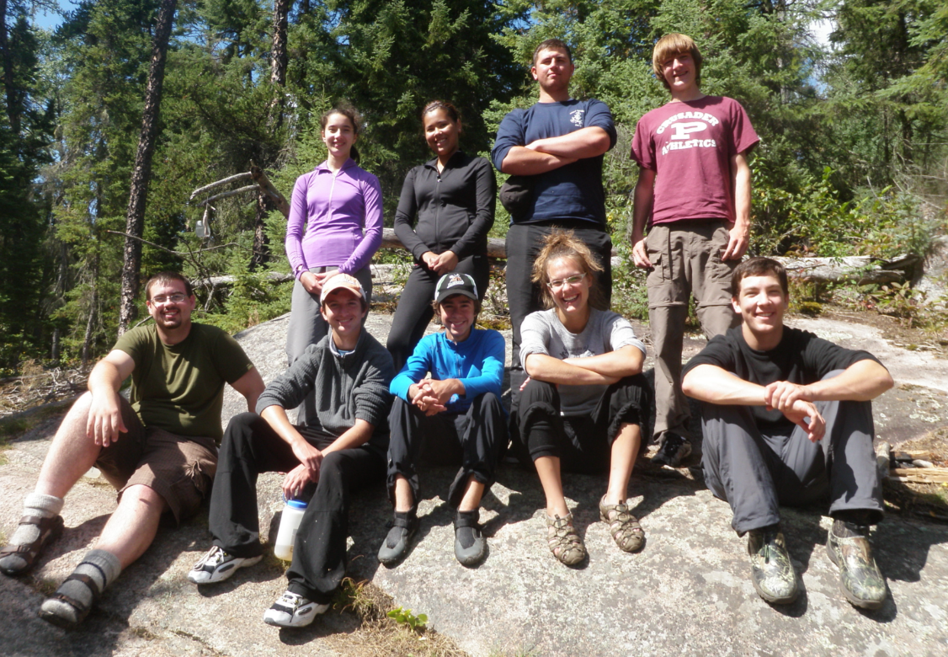
The Award will help you:
Never give up when things get tough 💪
Feel confident in yourself ✨
Be awesome at chatting with people 👫
Make friendships that last a lifetime 🤝
Get stronger 🏋️‍♂️
Develop critical thinking🧠
Improve at school 📚
Do the right thing 🌈
Make a difference in your community 🤲
© 2024 The Duke of Edinburgh's International Award – Canada, All Rights Reserved
Notes:
When participants choose activities that align with the criteria of the Award and are supported by mentors who share a commitment to these principles, remarkable outcomes emerge for participants. Young people who build and develop the skills that will support them as they navigate the transition from youth to adulthood receive:
Resilience & Determination: Participants develop the resilience to overcome challenges and the determination to achieve their goals.
Confidence: Through meaningful experiences, participants build confidence in their abilities and decision-making.
Interpersonal & Socialization Skills: Engaging in diverse activities fosters the development of interpersonal and social skills, crucial for building relationships and navigating social situations.
Leadership & Relationship Building: Participants learn to lead by example, collaborate effectively, and build positive relationships with others.
Physical Fitness & Health: Improved physical fitness and a healthy lifestyle.
Problem-Solving Skills: Participants develop critical thinking and problem-solving abilities through real-world challenges.
Success at School: The skills and competencies gained through the Award program contribute to academic success and personal growth.
Ethical Values: Participants cultivate honesty, fairness, empathy, and a sense of responsibility towards others.
Volunteerism: Participation in community service and volunteer activities, fostering a sense of social responsibility and empathy towards others.

Slide 5
How the Award Works
Be a Community Superstar! (Voluntary Service) – Make a difference in your community! 🌟
Turn Fitness into Fun! (Physical Recreation) - Stay active and healthy
while adding your own touch of fun! 🏃‍♂️
Transform Your Passion into Power! (Skill) – Tap into your passions and interests while doing the things that you love! 🎨
Plan an Epic Quest with Your Squad! (Adventurous Journey) - Get ready for an epic adventure and have the time of your life with a team! 🌄
© 2024 The Duke of Edinburgh's International Award – Canada, All Rights Reserved.
Notes:
There are four sections to complete for each Award level, plus a Gold Project that is completed only at the Gold Award level. Keep in mind, you are required to complete every section of the Award! You cannot pick and choose to do only the Service section or Physical Recreation – you must complete all of them to finish your Award!
Section Major: All participants starting at Bronze are Direct Entrants and must complete an additional 13 weeks in one Section (Voluntary Service, Skill, OR Physical Recreation).
Be a Community Superstar! (Voluntary Service) – Get ready to make a difference in your community! Learn how to lend a helping hand, spread kindness, or give back to others. It's all about making a positive impact and being a hero in your own way!
Turn Fitness into Fun! (Physical Recreation) - Whether you're hitting the gym, going for a run, or playing your favorite sport, it's all about staying active and healthy while adding your own touch of fun.
Transform Your Passion into Power! (Skill) – Tap into your passions and interests to discover awesome new abilities. It's all about trying new things, growing, and becoming the coolest version of yourself while doing the things that you love!
Plan an Epic Quest with Your Squad! (Adventurous Journey) - Get ready for an epic adventure with a team! It's time to explore, take on challenges, and have the time of your life while discovering what you're truly made of!
*Spend approximately an hour per week on each section. For Direct Entrants – you must select one of Service, Physical Recreation or Skills to be your Major section.

Slide 6
SMART Goals
🎯 You will need to make a SMART goal for each of your activities. SMART stands for Specific, Measurable, Achievable, Realistic, and Time-bound.
Example SMART Goal for Skill: Over the next 13 weeks, I will dedicate 1 hour per week to my building skills in Minecraft. I will focus on building techniques, like detailing and interior design to create cool structures.
© 2024 The Duke of Edinburgh's International Award – Canada, All Rights Reserved
Notes:
*Here is where you should utilize the SMART Goal worksheet with participants, so they know how to make SMART goals for their activities*:
SMART goals are like maps for your dreams. They help you figure out exactly where you want to go and how to get there. SMART stands for Specific, Measurable, Achievable, Realistic, and Time-bound.
So, when you make a goal for each of your activities, make sure it’s super clear (Specific), you can track your progress (Measurable), it's something you can actually do (Achievable), it’s sensible (Realistic), and you give yourself a deadline (Time-bound). That way, you'll know exactly what steps to take to make your dreams come true!

Slide 7
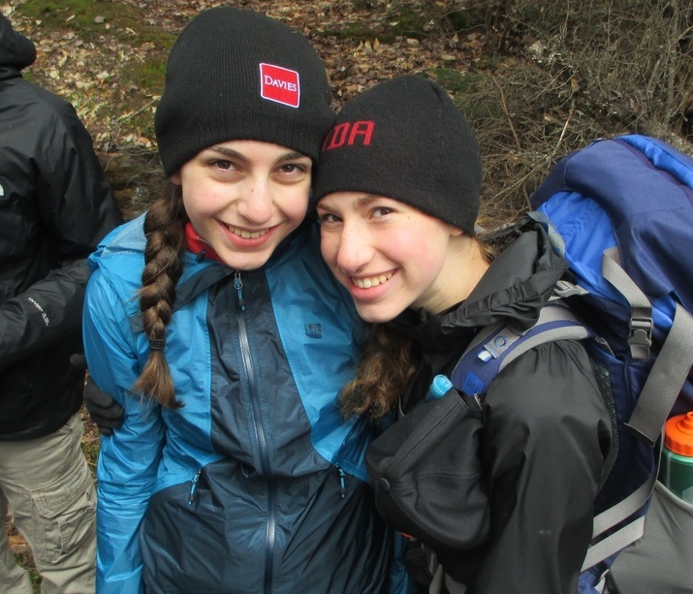
Your Activities Count if You Use the 7 Elements of the Award Canada Way:
1. Follow the Award framework 📋
2. Set SMART Goals. Use ChatGPT for help! 🎯
3. Choose activities that you enjoy 🎉
4. Pick activities that help you grow 🌱
5. Find Assessors for advice and help 🙋‍♂️
6. Do things that challenge you and teach you new skills 🚀
7. Think about what you did, learned, and how to improve 🤔
© 2024 The Duke of Edinburgh's International Award – Canada, All Rights Reserved
Notes:
*Feel free to utilize the ‘Does Your Activity Count’ Resource with participants here, which includes the 7 elements. They can refer to this sheet whenever they are unsure*:
Your activities count if you use the 7 Elements of The Award Canada Way:
☑ Is your activity following the Award framework? For example, for Bronze: (i) Are you over 13.5 years old? (ii) Have you chosen activities for 13 weeks and selected one to continue for 26 weeks?
☑ Did you set a SMART goal? Use Chat GPT or our SMART Goal worksheet if you need help.
☑ Did you choose an activity that matches your interests and passions?
☑ Did you choose an activity that has a meaning and purpose for you?
☑ Did you find an Assessor who will support you in developing your SMART goal, provide support, and submit a short assessment at the end of your activity on your progress?
☑ Will your activity challenge you and help you learn new things?
☑ Will you take time to reflect on your progress?
Top Tip: Try Chat GPT or CoPilot for prompts for activity ideas using a starting idea or to help you get started on making SMART goals. When using Chat GPT, use it only as a starting point. You will have to adjust the response ChatGPT gives you, as it is not always accurate.

Slide 8
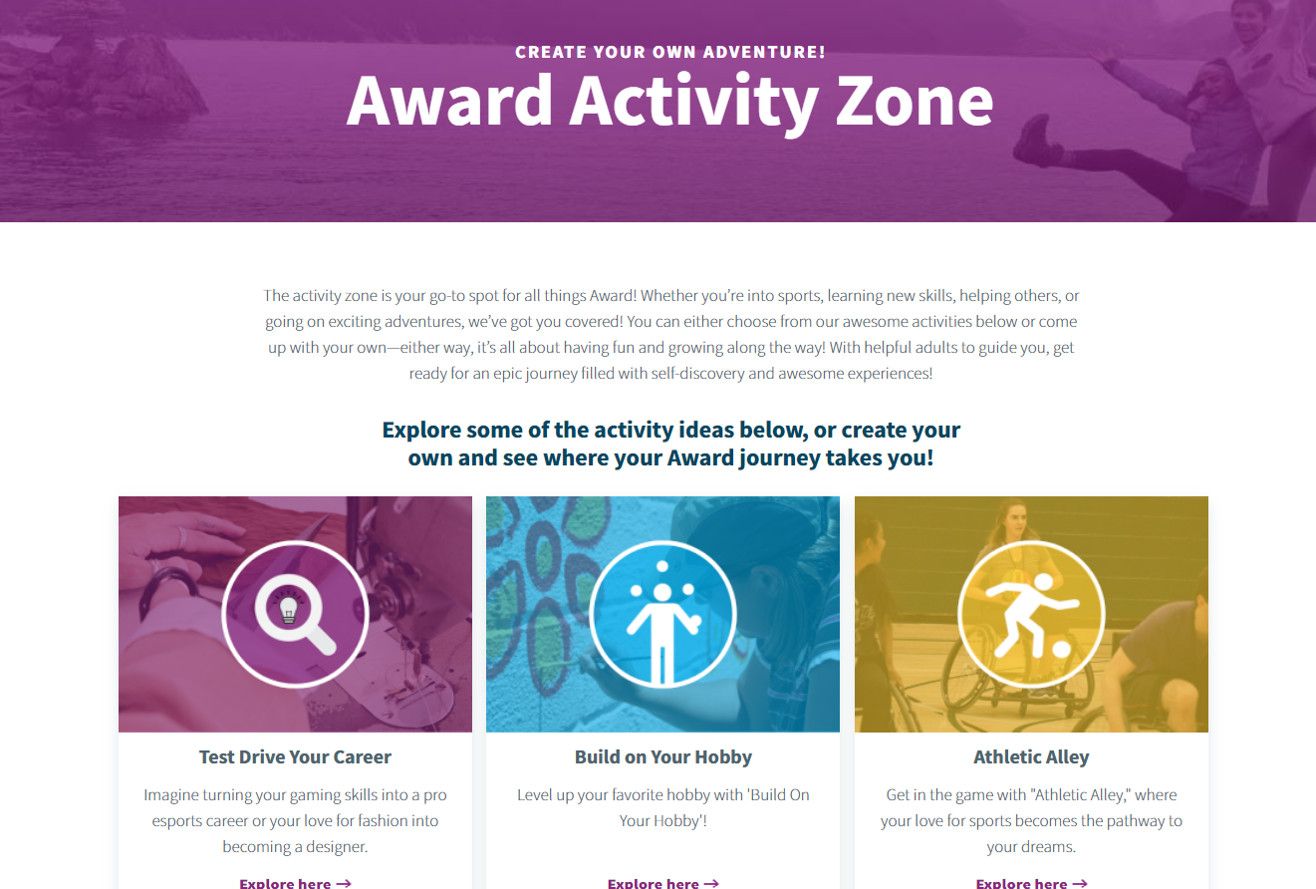
Get Creative - Use The Activity Zone!
The Activity Zone is your go-to spot for activity ideas! You can either choose from our awesome activities below or come up with your own—either way, it’s all about having fun and growing along the way!
Explore some of the activity ideas or create your own and see where your Award journey takes you. And remember, you can do all of them with friends and/or use school activities!
https://www.dukeofed.org/award-activity-zone/
© 2024 The Duke of Edinburgh's International Award – Canada, All Rights Reserved.
Notes:
Link to Activity Zone: https://www.dukeofed.org/award-activity-zone/
Now, let's take a look at the Activity Zone on the Award website. This is a great resource to start exploring potential activities for your Award. As you browse, start thinking about what activities you might want to pursue, especially for your Major section. It's important to have your Major section set up on the Online Record Book (ORB) within the first 3-4 weeks, including your SMART goal and Assessor details.
Research indicates that participants who log four or more entries in one section early on have over an 80% chance of completing the program. This demonstrates that focusing on one section initially can significantly boost your chances of successfully completing your entire Award. So, I encourage you to start early and stay consistent in recording your activities.

Slide 9
Get Creative - Use The Activity Zone!
You'll see that there are many different activities you can choose from in the Activity Zone.
By choosing activities that align with your passions and interests, you can make your participation in the Award even more meaningful and enjoyable.
Remember, the key is to select activities that you are genuinely interested in, so they can count towards your Award and keep you motivated throughout the process.
© 2024 The Duke of Edinburgh's International Award – Canada, All Rights Reserved
Notes:
Let's emphasize the variety of options available in the Activity Zone. If you explore this webpage, you'll see that there are many different activities you can choose from. Whether you’re into sports, learning new skills, helping others, or going on exciting adventures, there’s something in here for everyone!
By aligning your activities with your passions and interests, you can make your participation in the Award even more meaningful, fun and enjoyable. Remember, the key is to select activities that you are genuinely interested in, so they can count towards your Award and keep you motivated throughout the process.

Slide 10
Get Creative - Use The Activity Zone!
Think about choosing one interest or hobby you enjoy and using it for all your sections.
This allows you to explore your passion while developing a diverse range of skills and experiences.
However, to maximize your learning and gain stories that will benefit you in post-secondary applications, it's also important to seek variety within that theme. Your Assessor can help you.
Think about collaborating with a friend or using this opportunity to make new friends who share your interests!
© 2024 The Duke of Edinburgh's International Award – Canada, All Rights Reserved
Notes:
Consider taking a thematic approach by choosing one interest or hobby you enjoy and incorporating it into all your sections. This method allows you to dive deeper into your passion while developing a diverse range of skills and experiences.
However, to maximize your learning and gain stories that will benefit you in post-secondary applications, it's also important to seek variety within that theme. Your assessor can provide guidance on this. Think about collaborating with a friend or using this opportunity to make new friends who share your interests.
By choosing a thematic approach, you can make your activities more enjoyable and meaningful while also building a well-rounded set of experiences.

Slide 11
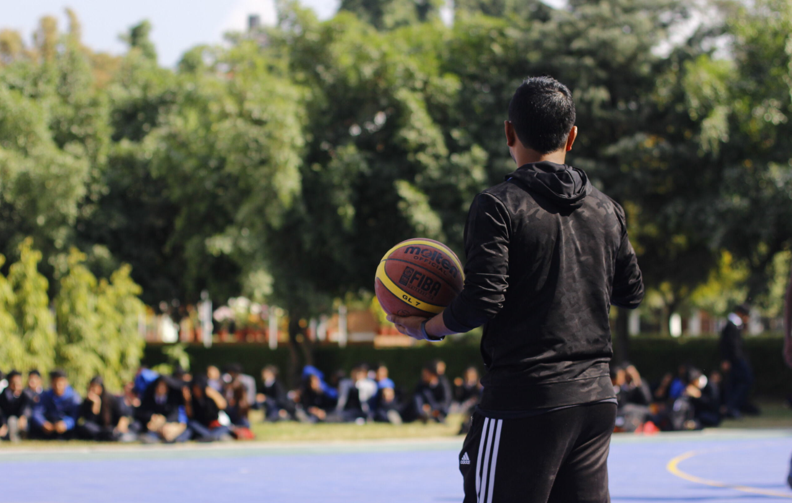
Get Creative - Use The Activity Zone!
For example, if you enjoy fashion, you could:
Skill: Learn tie-dye techniques, sewing, or fashion styling.
Physical Recreation: Runway training sessions or fashion dance routines.
Voluntary Service: Clothing donation or volunteer at a thrift store.
If you are passionate about hockey, you could:
Skill: Analyze old hockey games to understand gameplay mechanics.
Physical Recreation: School hockey team or street hockey.
Voluntary Service: Volunteer to help with hockey games or coach younger players.
© 2024 The Duke of Edinburgh's International Award – Canada, All Rights Reserved
Notes:
For example, if you enjoy fashion, you could:
Skill: Learn tie-dye techniques, sewing, or fashion styling.
Physical Recreation: Runway training sessions or fashion dance routines.
Voluntary Service: Clothing donation or volunteer at a thrift store.
If you are passionate about hockey, you could:
Skill: Analyze old hockey games to understand gameplay mechanics.
Physical Recreation: School hockey team or street hockey.
Voluntary Service: Volunteer to help with hockey games or coach younger players.

Slide 12
Do Award Activities With Your Friends!
You can do all your Award activities with your friends!
Having friends alongside can provide extra support and encouragement.
So, consider teaming up with your friends as you plan and carry out your activities. It’s a fantastic way to share experiences, stay committed, and have fun together while working towards achieving your Award.
© 2024 The Duke of Edinburgh's International Award – Canada, All Rights Reserved
Notes:
Another great aspect of the Award is that you can do all of your Award activities with your friends. This can make the experience more enjoyable and motivating. Whether it's the Physical, Skill, or Voluntary Service, having friends alongside can provide extra support and encouragement. So, consider teaming up with your friends as you plan and carry out your activities. It’s a fantastic way to share experiences, stay committed, and have fun together while working towards achieving your Award.

Slide 13
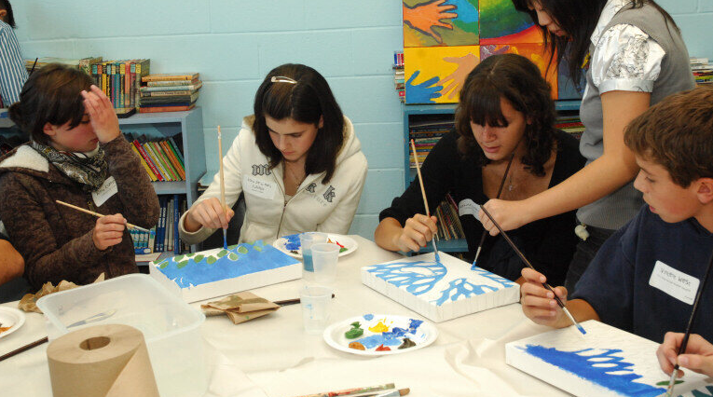
Award Activities Within Your School!
You can also complete all your Award activities at school!
Whether it’s participating in a sports team, using your band class, or doing community service at school, these activities can all count towards your Award, as long as they use the 7 elements and have a SMART Goal to improve in each activity you choose.
© 2024 The Duke of Edinburgh's International Award – Canada, All Rights Reserved
Notes:
You can also complete all your Award activities within your school!
Whether it’s participating in a sports team, using your band class, or doing community service at school, these activities can all count towards your Award, as long as they have the 7 elements.
The important thing is to set a SMART Goal to improve in each activity you choose. By focusing on personal growth and development, you can make the most of the opportunities available right here at school while working towards your Award!

Slide 14
More Activity Ideas
*Here is where you insert specific examples of activities within your school that participants can use for their Award activities, or how they can use their interests to come up with a school activity they can use* ☺
© 2024 The Duke of Edinburgh's International Award – Canada, All Rights Reserved
Notes:
You can utilize the following document for instructions on how Award Centres can implement school activities into the Award if you aren’t sure. For example, here you can incorporate how students might use their band class, school sports team, or volunteering at the breakfast program for their Award activities!

Slide 15
Adventurous Journey!
*Here is where you insert pictures of what your Award Centre does for the Adventurous Journey and explain it to them to get students excited!* ☺
© 2024 The Duke of Edinburgh's International Award – Canada, All Rights Reserved
Notes:
The Adventurous Journey encourages a spirit of adventure and discovery while planning and undertaking a journey with a small team of peers. Teams work together to set a clear and challenging goal that is achievable and defines what activities they will be doing throughout their journey. You will do a Practice and a Qualifying Journeys. The AJ can take place in urban, rural or wilderness environments. It’s not just a camping trip, teams may choose to discover local features, cycle between cities, design a zombie apocalypse escape route, or explore historical sites- the possibilities are endless!
The Practice Journey serves as a preparatory adventure undertaken by the team, with guidance from their adult mentor(s). It is designed to ensure that the team is adequately prepared, well-trained, and equipped with the necessary skills and resources for a safe and successful Qualifying Journey.
The Qualifying Journey provides the team with a chance to apply their acquired skills and knowledge to undertake a challenging and achievable journey. They will demonstrate their ability to collaborate effectively and safely work together to achieve their chosen goal.
All AJ team members work together to plan and prepare for the journey with the support of an adult mentor (this may include their Award Leader, AJ Assessor and/or AJ Supervisor).
Together, the team decides on a mode of travel, a team goal and an environment where they can safely travel. Teams train, plan and prepare to make sure they have the skills and resources they need to safely complete their journey.

Slide 16
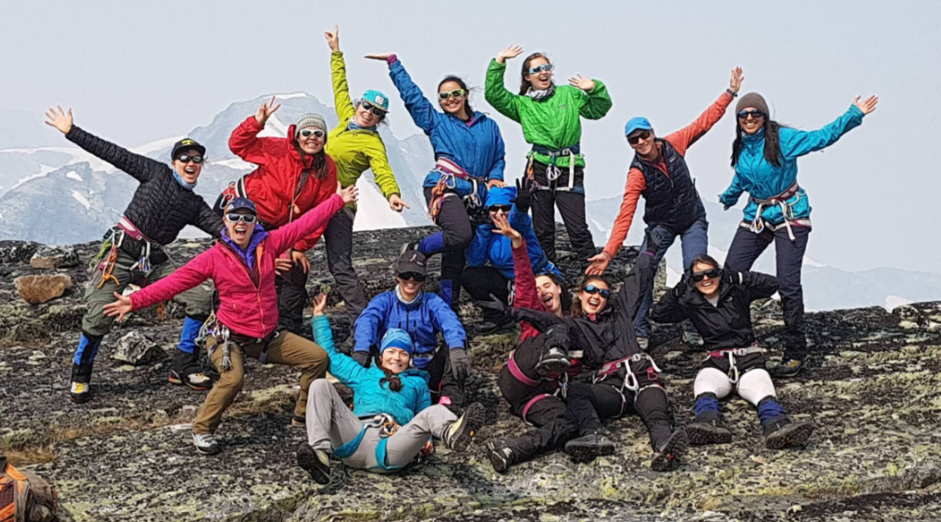
Assessors
You'll need to choose an Assessor for each section of the Award. They'll guide you along the way.
An Assessor could be a teacher 📚, a coach 🏅, a community member 🏘️, family friend 👫, etc. (not family).
You can reach out to them via email 📧, phone ☎️, or in person 🤝
© 2024 The Duke of Edinburgh's International Award – Canada, All Rights Reserved
Notes:
Here, you can utilize the following documents with participants:
Section Assessor Information Sheet:
How to Choose and Reach out to an Assessor: https://www.dukeofed.org/wp-content/uploads/2024/05/Information-about-choosing-an-Award-Assessor.pdf

Slide 17
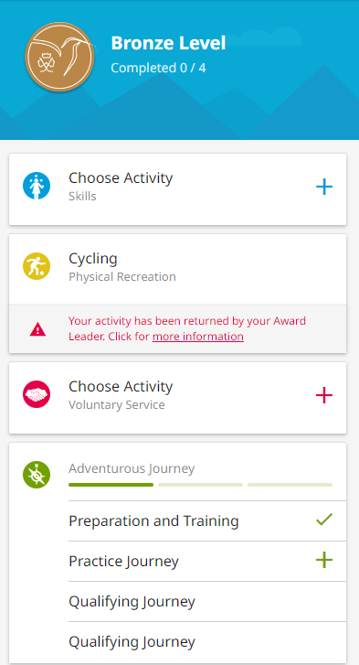
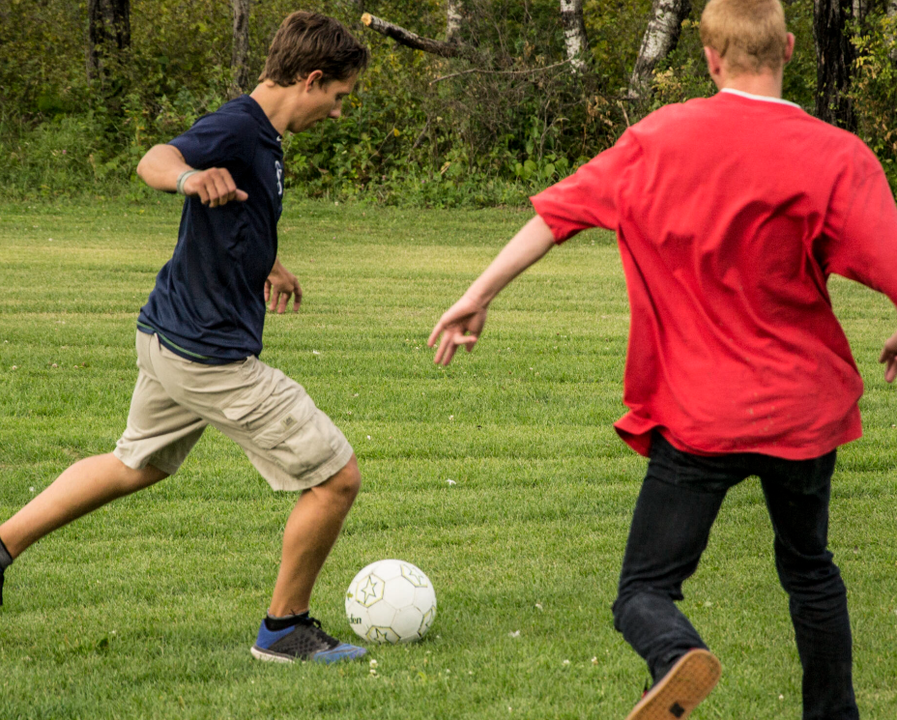
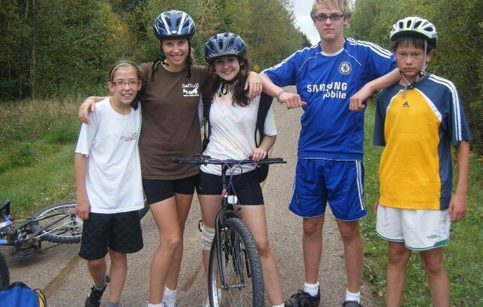
Online Record Book (ORB)
🌐 The ORB is the online platform where you will add your activities, SMART Goals, and Assessors. You will enter weekly logs for each activity on the ORB until you finish your Award!
Example Log for ORB: “Today my friends and I passed the soccer ball at the local park. We focused on our form and having fun!”
© 2024 The Duke of Edinburgh's International Award – Canada, All Rights Reserved
Notes:
The ORB is the online platform where you will input your activities, SMART Goals for each activity, and Assessors. You will enter weekly logs for each activity on the ORB until you finish your Award!
If you want to go into more detail about the ORB or logging, you utilize the logging example document:

Slide 18
How to Set Up an Activity on ORB
© 2024 The Duke of Edinburgh's International Award – Canada, All Rights Reserved.
Notes:
https://www.youtube.com/watch?v=6U70drd337g

Slide 19
How to Create a Log on ORB
© 2024 The Duke of Edinburgh's International Award – Canada, All Rights Reserved
Notes:
https://www.youtube.com/watch?v=6biSEb_U3K8

Slide 20
Ready to Begin?!
*Here is where you can end the session by inserting more pictures of previous students doing their Award at your school to get students excited!* ☺
© 2024 The Duke of Edinburgh's International Award – Canada, All Rights Reserved

Slide 21
GENERAL CONTACT DETAILS
858A King Street West Toronto, ON M5V 1P1 Phone: (437) 747-0449 Email: support@dukeofed.org
Monday – Thursday:
Chat: 10:00 - 6:00 PM EST
Phone: 11:00 - 8:00 PM EST
Charitable Registration Number: 12391 6751 RR0002
www.dukeofed.org
FOLLOW US ON SOCIAL MEDIA!
@dukeofedcanada
@dukeofedcanada
@dukeofedcanada
www.linkedin.com/company/dukeofedcanada
© 2024 The Duke of Edinburgh's International Award – Canada, All Rights Reserved

