Slide 1
Read Me First: Teacher Instructions
‘Session Zero’ is designed to provide an engaging and straightforward introduction to the Award without overwhelming the details, igniting participants’ enthusiasm from the start. Ideally, this introduction would be scheduled in May/June before the school year starts or in September, so teachers can work with grade 8’s to introduce the Award before summer vacation.
Accessing Slide Notes
Optional notes are provided for all slides. To view the notes, type 'notes' in the PowerPoint search bar and select 'Show/Hide Notes Pane’.
Optional Registration Slide
For presentations held in May or June, there is an optional slide to include student registration as part of this session to have it complete before September.
© 2024 The Duke of Edinburgh's International Award – Canada, All Rights Reserved

Slide 2
Award Canada
Welcome to the Award: Session Zero
© 2024 The Duke of Edinburgh's International Award – Canada, All Rights Reserved.
Notes:
***All notes are a suggested guide to use. Please read through all notes ahead of presenting and feel free to make your own during the presentation.****
Hello everyone! Today, we’re going to learn about an exciting program called the Award. This program helps you develop new skills, stay active, help others, meet amazing people, and go on amazing adventures. Let’s dive into this interactive session and see what it’s all about!

Slide 3
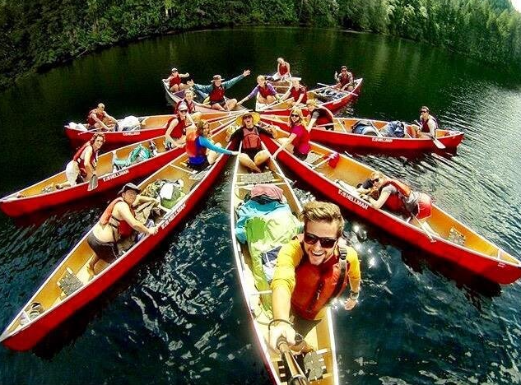
How the Award Works
Be a Community Superstar! (Voluntary Service) – Make a difference in your community! 🌟
Turn Fitness into Fun! (Physical Recreation) - Stay active and healthy
while adding your own touch of fun! 🏃‍♂️
Transform Your Passion into Power! (Skill) – Tap into your passions and interests while doing the things that you love! 🎨
Plan an Epic Quest with Your Squad! (Adventurous Journey) - Get ready for an epic adventure and have the time of your life with a team! 🌄
© 2024 The Duke of Edinburgh's International Award – Canada, All Rights Reserved
Notes:
Welcome to your introduction all things Award! There are four sections to complete for each Award level, and you’ll have a blast doing them! And, you can do them all with friends!
Be a Community Superstar! (Voluntary Service) – Get ready to make a difference in your community! Learn how to lend a helping hand, spread kindness, or give back to others. It's all about making a positive impact and being a hero in your own way!
Turn Fitness into Fun! (Physical Recreation) - Whether you're hitting the gym, going for a run, or playing your favorite sport, it's all about staying active and healthy while adding your own touch of fun.
Transform Your Passion into Power! (Skill) – Tap into your passions and interests to discover awesome new abilities. It's all about trying new things, growing, and becoming the coolest version of yourself while doing the things that you love!
Plan an Epic Quest with Your Squad! (Adventurous Journey) - Get ready for an epic adventure with a team! It's time to explore, take on challenges, and have the time of your life while discovering what you're truly made of!

Slide 4
Adventure into the Activity Zone!
Let's start by exploring the Activity Zone webpage together. It's a great place to find fun activity ideas in the four different categories. Choose the pathway that fits your Award Centre.
We'll focus on three sections: Skill, Voluntary Service, and Physical Recreation, and look at the Adventurous Journey separately.
Link: Activity Zone
Class Activity: We’ll view the webpage as a class and then brainstorm creative activity ideas. Remember, you can do these activities with friends or at school!
© 2024 The Duke of Edinburgh's International Award – Canada, All Rights Reserved
Notes:
To learn about the fun four sections of the Award, we are going to start by looking at the Activity Zone webpage together. The Activity Zone is a webpage where you get ideas to choose fun activities in the four categories.
Link to Activity Zone: https://www.dukeofed.org/award-activity-zone/
For this activity, we are going to focus on Skill, Voluntary Service, and Physical Recreation, and do a separate Adventurous Journey activity next.
We are going to view this webpage as a class and then you will all come up with creative, fun ideas. Remember, you can do all your activities with friends or even in school so keep that in mind when you’re creating!
*View whichever pathway of the Activity Zone you want to engage your students with*

Slide 5
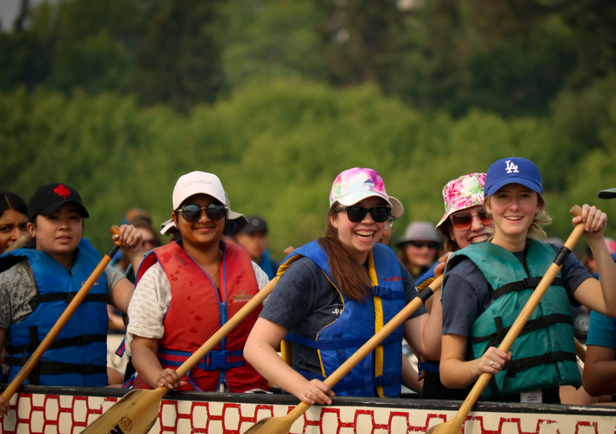
Adventure into the Activity Zone!
Interactive Activity: Brainstorm Session
Skill: Think of a skill you want to learn or improve. (guitar, gaming, baking, drawing, etc.)
Physical Recreation: Choose a physical activity you enjoy. (soccer, swimming, dance, etc.)
Volunteering: Find ways to help your community. (animal shelter, community garden, etc.)
Group Discussion: Pair up with a classmate, share your ideas, then present your pair’s ideas to the class.
© 2024 The Duke of Edinburgh's International Award – Canada, All Rights Reserved
Notes:
Interactive Activity:
Brainstorm Session:
Skill Development: Have students think of a skill they want to learn or improve. (e.g., playing a guitar, gaming, baking, drawing, etc)
Physical Recreation: Have students pick a sport or physical activity they enjoy. (e.g., soccer, swimming, dance, etc)
Volunteering: Have students think of ways they can help their community. (e.g., volunteering at an animal shelter, helping out at a community garden, etc)
Group Discussion: Pair up each student with a classmate and share each other's ideas. Then, have the students share the pair’s ideas with the class.

Slide 6
Plan Your Adventure!
The Activity Zone will also inspire you with awesome journey ideas for the Adventurous Journey section. Let's look at some AJ ideas in 'Lead with Adventure' on the Activity Zone: https://www.dukeofed.org/lead-with-adventure/
Then, we're going to plan an exciting adventure! Get as creative as you can. Your adventure could be something close to home, like exploring your local neighborhood, or a bit further out, like backcountry camping.
Adventure Planning Details:
Overnight Stay: Your adventure must include a self-sufficient overnight stay. Think about where you'd like to sleep—tents, the school field, or even the school gym.
Team Goal: Every adventure needs a goal. Think about what you want to achieve as a team.
Mode of Travel: Decide how you'll travel—on foot, by bike, kayak, etc.
Nutritious Meals: Plan to prepare and eat a nutritious meal each day.
© 2024 The Duke of Edinburgh's International Award – Canada, All Rights Reserved
Notes:
The Activity Zone will also give you ideas for awesome journeys with your friends for the Adventurous Journey section. Alright class, now we are going to plan an exciting adventure! I want you all to get as creative as possible. Your adventure could be something close to home, like exploring your local neighborhood, or something a bit further out like backcountry camping.
Quickly go over AJ ideas in the Activity Zone. Link to ‘Lead with Adventure’ Activity Zone: https://www.dukeofed.org/lead-with-adventure/
Your adventure needs to include an overnight stay. This could be in tents, on the school field, or even in the school gym. Think about where you'd like to sleep during your adventure.
Every adventure needs a goal! This goal will help guide your planning. Your goal should be about what you want to accomplish as a team. You don't need to finalize your goal, but have an idea in mind to share with the class.
You will also need to decide on a mode of travel. You could go on foot, ride bikes, or even kayak or canoe if you're planning something near water. You will also need to make sure you prepare and eat a nutritious meal each day. Think about what kinds of meals you can easily make and enjoy during your trip.

Slide 7
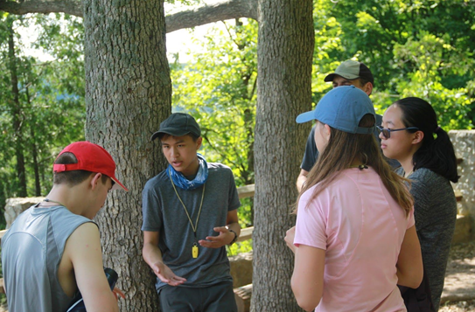
Plan Your Adventure!
Example Adventures:
Setting up a base camp from your favorite video game
Designing a zombie apocalypse escape route
Backcountry hiking
Kayaking or canoeing
Ice climbing
Car spotting in your neighborhood
Interactive Activity: Planning Session
In groups of four, plan a mock trip. Decide on a location, what to pack, what you will do, what you will cook, and where you'll stay.
Each group will present their plan to the class.
© 2024 The Duke of Edinburgh's International Award – Canada, All Rights Reserved
Notes:
Here are some example ideas to help you get started:
Setting up a base camp from your favorite video game
Designing a zombie apocalypse escape route
Backcountry hiking and camping
Kayaking or canoeing
Ice climbing
Car spotting in your neighborhood
So, start thinking about your adventure!
Interactive Activity:
Planning Session:
In groups of four, have students plan a mock trip.
Decide on a location, what you need to pack, what you will do, where you will stay, etc.
2. Presentation: Each group presents their plan to the class.

Slide 8
Explore The Award Canada Blog!
The Award Canada Blog is a fantastic place to read about other students’ experiences, and maybe even have yours featured one day!
Blog Discussion
Read: As a class, read a story from the Award Canada Blog: Link
Discuss: Talk about what you liked about the story.
What part of the story captured your attention the most?
Could you relate to any experiences or emotions described in the story?
What aspects of the story were inspiring to you?
Did the story motivate you to pursue a particular goal or activity related to the Award categories?
© 2024 The Duke of Edinburgh's International Award – Canada, All Rights Reserved
Notes:
The Award Canada Blog is where you can read about other students’ experiences, and maybe have yours featured one day.
Link to The Award Canada Blog:
Blog Discussion: Read a story from the Award Canada Blog as a class and discuss what you liked about it.
Suggested prompts: What part of the story captured your attention the most? Could you relate to any experiences or emotions described in the story? What aspects of the story were inspiring to you? Did the story motivate you to pursue a particular goal or activity related to the Award categories?

Slide 9
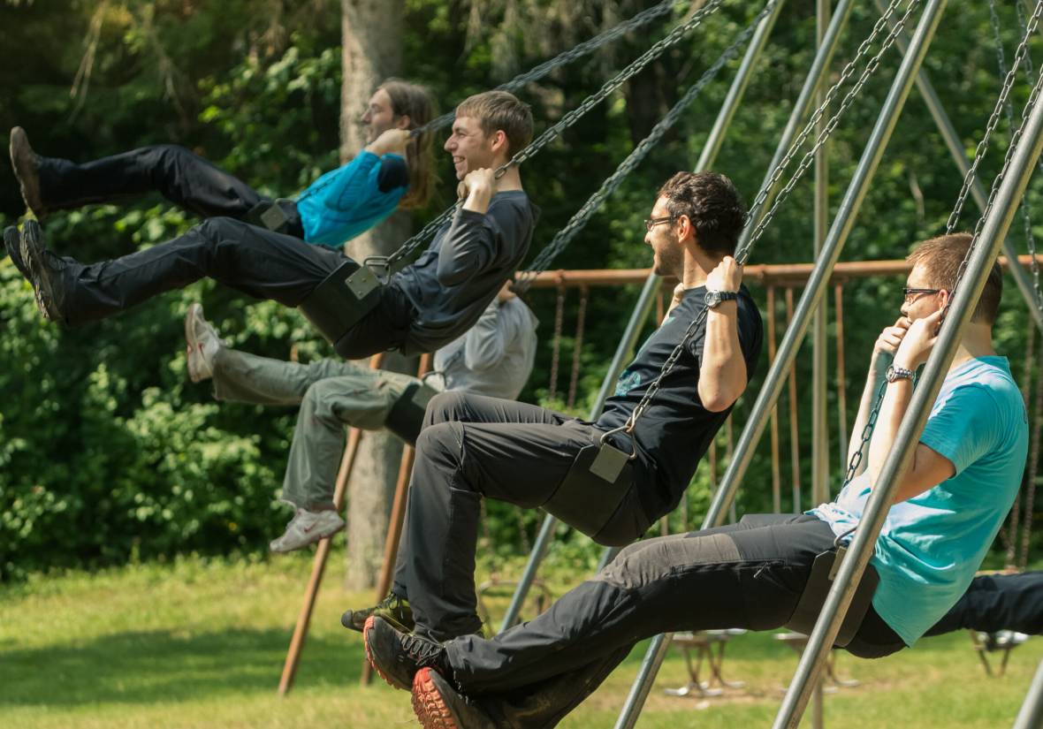
Explore The Award Canada Blog!
Interactive Activity: Story Writing
Reflect: Think about an adventure or activity that has been meaningful to you. It could be a hiking trip, a volunteer experience, a skill you've developed, or any other memorable moment.
Share: In groups of 2-4, share a short story about your adventure or a favorite activity.
Class Sharing: Share some of these stories with the class.
© 2024 The Duke of Edinburgh's International Award – Canada, All Rights Reserved
Notes:
2. Story Writing - Take a moment to think about an adventure or an activity that has been meaningful to you. It could be a hiking trip, a volunteer experience, a skill you've developed, or any other memorable moment.
In groups of 2-4, share a short story about an adventure you’ve had or an activity you enjoy.
Share some of the stories with the class.

Slide 10
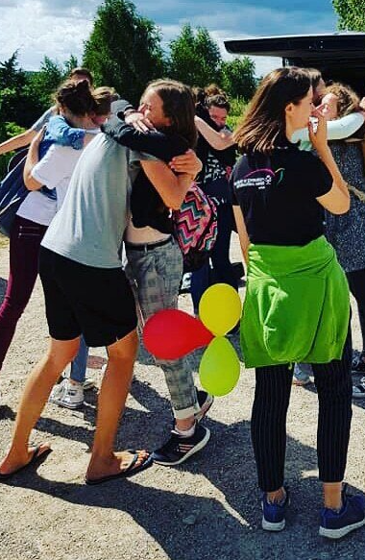
Friends Make Fun Happen!
Doing activities with friends can make everything more fun. You can do all your Award activities with friends, if you wish!
Think about an activity you love or have been wanting to try. It could be playing a sport, video games, baking, volunteering, or anything else. Then on the next slide, we’ll do an interactive activity.
© 2024 The Duke of Edinburgh's International Award – Canada, All Rights Reserved
Notes:
Doing activities with friends can make everything more enjoyable and fulfilling, just like how you can do all your Award activities with friends, if you wish to!
Interactive Activity Outline:
Think about an activity you love to do or have been wanting to try. It could be playing a sport, video games, baking, volunteering for a cause, etc. Find a friend who is interested in the same activity and brainstorm how you can collaborate.

Slide 11
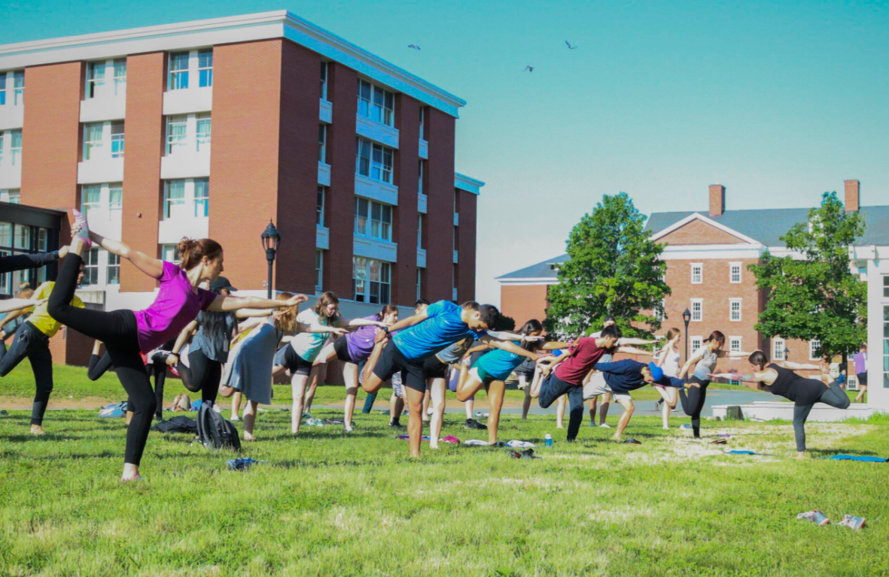
Friends Make Fun Happen!
Interactive Activity
1. Find a friend and either share an interest (e.g., sports, video games, baking, volunteering) or be randomly assigned a partner.
2. Plan how you could do an activity together. For example, if you both like cooking, plan to hang out on Saturday afternoons to cook something fun, listen to music, and learn together!
Class Sharing
Each pair shares their plans with the class.
As a class, discuss how working with friends can enhance the activity.
© 2024 The Duke of Edinburgh's International Award – Canada, All Rights Reserved
Notes:
Interactive Activity
1. Pair Up: Find a friend and either share an interest (e.g., sports, video games, baking, volunteering) or be randomly assigned a partner.
2. Plan Together: Discuss and plan how you can do this activity together. For example, if you both like cooking, plan to hang out on Saturday afternoons to cook something fun, listen to music, and learn together!
Class Sharing
Share Your Plans: Each pair shares their plans with the class.
Discussion: As a class, discuss how working with friends can enhance the experience of the chosen activity.

Slide 12
Explore Award Activities at School!
Let’s discover how you can participate in Award activities right here at school!
Think about clubs or activities at school that interest you. It could be a drama club to improve your acting skills, helping out in the school garden, joining a sports team, or playing an instrument in band class.
As long as you have a goal to improve, it can likely count towards your Award!
© 2024 The Duke of Edinburgh's International Award – Canada, All Rights Reserved
Notes:
Now we're going to explore how you can participate in Award activities right here at school!
Think about clubs or activities you're interested in at school. It could be a drama club to improve your acting skills, gardening the school garden help out in the community, or playing on a sports team to stay active, playing an instrument in band class, etc. As long as you have a goal in mind to improve, it can likely count.

Slide 13
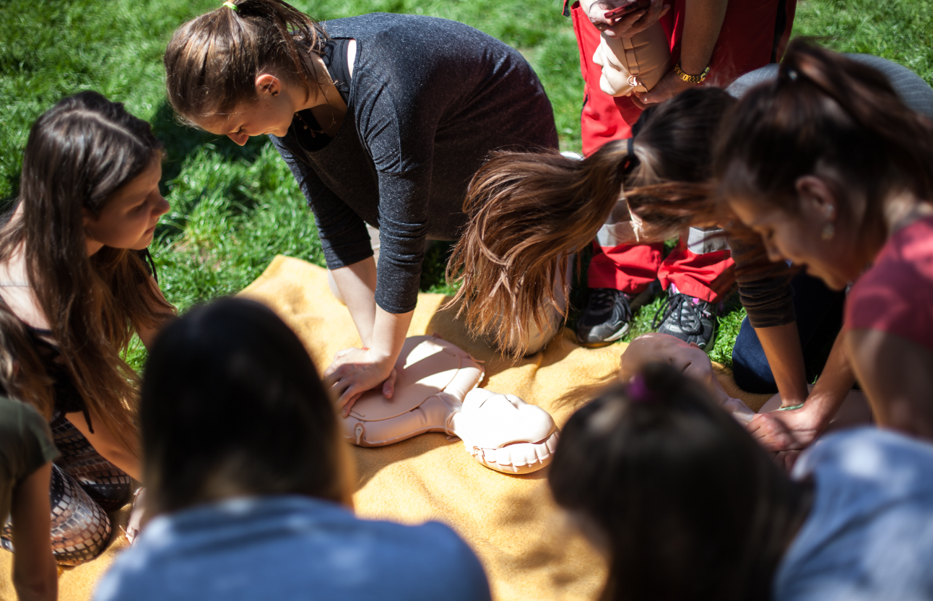
Explore Award Activities at School!
Interactive Activity: Club Hunt
As a class, list school clubs or activities that fit into the Award categories (Skill, Voluntary Service, Physical Recreation).
Interactive Activity: Event Planning
In groups, come up with a cool event idea for school that could count towards the Award. Ideas could include a charity run, a talent show, or any activity that showcases your skills or helps the community.
Present your event idea to the class. Let’s hear your ideas and see how we can make our school even more awesome!
© 2024 The Duke of Edinburgh's International Award – Canada, All Rights Reserved
Notes:
Interactive Activity:
Club Hunt:
Task: Have students list out school clubs or activities that fit into the Award categories (like Skill, Voluntary Service, Physical Recreation).
Now, in groups, think of a cool event we could do at school that could also count for the Award. Maybe it's a charity run to raise money, or a talent show to showcase skills. Share your idea with the class when you're done. Let's hear your ideas and see how we can make our school even more awesome!
2. Event Planning:
Task: In small groups, come up with an idea for a school event that could count towards the Award (like a charity run or a talent show).
Presentation: Present your event idea to the class.

Slide 14
Kahoot Quiz!
Let's Play a Kahoot Quiz!
To make sure everyone’s excited and ready, let’s play a Kahoot quiz about what we’ve learned today!
How to Play:
Open the Kahoot app or go to kahoot.it on your device.
Enter the game PIN provided by your teacher.
Answer the questions as they appear on the screen.
Go over the answers as a class.
© 2024 The Duke of Edinburgh's International Award – Canada, All Rights Reserved
Notes:
To make sure everyone’s excited and ready, let’s play a Kahoot quiz about what we’ve learned today!
How to Play:
Open the Kahoot app or go to kahoot.it on your device.
Enter the game PIN provided by your teacher.
Answer the questions as they appear on the screen.
Go over the answers as a class.
Sample Kahoot Questions:
What is one activity you can do for Skill?
Name a sport you can do for Physical Recreation.
Give an example of a Volunteering activity that could count towards the Award.
What should you bring on an Adventurous Journey?
What is the webpage called where you can find ideas and inspiration for your activities?
Where can you read stories from other Award participants?

Slide 15
Kahoot Quiz!
Sample Kahoot Questions:
Skill: What is one activity you can do for Skill?
Physical Recreation: Name an activity you can do for Physical Recreation.
Volunteering: Give an example of a volunteering activity that could count towards the Award.
Adventurous Journey: What should you bring on an Adventurous Journey?
Activity Ideas: What is the webpage called where you can find ideas and inspiration for your activities?
Award Stories: Where can you read stories from other Award participants?
© 2024 The Duke of Edinburgh's International Award – Canada, All Rights Reserved
Notes:
Sample Kahoot Questions:
What is one activity you can do for Skill?
Name a sport you can do for Physical Recreation.
Give an example of a Volunteering activity that could count towards the Award.
What should you bring on an Adventurous Journey?
What is the webpage called where you can find ideas and inspiration for your activities? → The Activity Zone
Where can you read stories from other Award participants? → The Award Canada Blog

Slide 16
GENERAL CONTACT DETAILS
858A King Street West Toronto, ON M5V 1P1 Phone: (437) 747-0449 Email: support@dukeofed.org
Monday – Thursday:
Chat: 10:00 - 6:00 PM EST
Phone: 11:00 - 8:00 PM EST
Charitable Registration Number: 12391 6751 RR0002
www.dukeofed.org
FOLLOW US ON SOCIAL MEDIA!
@dukeofedcanada
@dukeofedcanada
@dukeofedcanada
www.linkedin.com/company/dukeofedcanada
© 2024 The Duke of Edinburgh's International Award – Canada, All Rights Reserved

