Slide 1
Read Me First: Teacher Instructions
This PowerPoint is designed to introduce students to the Award before they register, ideally presented alongside your SHSM introduction to show SHSM linkage.
It's important to decide the best timing and setting for the Information Session, such as a luncheon learn, SHSM meeting, class, club or team.
Optional speaking notes are provided for all slides. To view the notes, type 'notes' in the PowerPoint search bar and select 'Show/Hide Notes Pane’.
© 2024 The Duke of Edinburgh's International Award – Canada, All Rights Reserved

Slide 2
Award Canada
Award-SHSM Information Session
© 2024 The Duke of Edinburgh's International Award – Canada, All Rights Reserved.
Notes:
Welcome! Today’s session will introduce how you can elevate your SHSM experience by adding the Award to your journey. We’ll explore how these two programs work together and how you can earn both an SHSM certification and an internationally recognized Award.

Slide 3
Benefits of Combining SHSM with the Award
Earn your SHSM certifications and be celebrated for them!
Earn prestigious, internationally recognized accreditation!
Get recognized for what you’re already doing through SHSM!
Boost your resume for jobs, scholarships, and post-secondary applications!
Choose activities that match your interests!
Continue the Award even if unable to complete your SHSM bundle!
Reflect on your experiences for deeper learning!
Develop key skills to thrive in the ever-changing job market!
Network with alumni worldwide!
© 2024 The Duke of Edinburgh's International Award – Canada, All Rights Reserved
Notes:
Now let’s explore the fantastic benefits of combining the SHSM program with the Award. This integration not only enriches your learning experience but also provides you with several advantages that can set you apart in the future.
1. Gain SHSM certifications!
Participating in the Award allows you to earn additional certifications through your SHSM activities, enhancing your skill set. For example, you might gain certifications in portfolio development, leadership or specific skills that are beneficial for your future career.
2. Earn prestigious, internationally recognized accreditation!
By completing the Award alongside your SHSM activities, you'll earn a prestigious accreditation that is recognized internationally. This credential is valuable for your future, whether you’re applying for jobs or continuing your education.
3. Get recognized for what you’re already doing through SHSM!
This is one of the best parts about combining SHSM with the Award—you’re already doing so many amazing things, and now you get even more recognition for them! A lot of your SHSM activities already count towards the Award, so there’s no need to reinvent the wheel or take on extra work. You're getting recognized for what you're already doing!
4. Boost your resume for jobs, scholarships, and post-secondary applications!
Having both the Award and SHSM on your resume shows employers and admissions committees that you are dedicated, proactive, and have engaged in valuable experiences. It makes your application stand out in a competitive environment.
5. Choose activities that match your interests!
The Award provides the flexibility to select activities that resonate with your passions and interests, aligning perfectly with your SHSM sectors. This means you can have fun while learning and growing in areas that excite you!
6. Continue the Award even without completing your SHSM bundle!
You can continue working on the Award even if you haven’t completed all your SHSM courses. This flexibility allows you to make the most of your time and opportunities without feeling restricted by academic requirements.
7. Reflect on your experiences for deeper learning!
Reflection is a core component of the Award. By reflecting on your SHSM activities and experiences, you deepen your understanding of what you’ve learned and how it applies to your future, making your learning more meaningful.
8. Develop key skills to thrive in the ever-changing job market!
Both SHSM and the Award focus on developing essential skills such as leadership, teamwork, and problem-solving. These skills are vital for success in today's dynamic job market and will prepare you for a variety of career paths.
9. Network with alumni worldwide!
Finally, by participating in the Award, you gain access to a global network of alumni. This can open doors to collaboration opportunities, mentorship, and new friendships that extend beyond your local community.
In summary, combining SHSM with the Award not only enhances your educational journey but also equips you with the skills, experiences, and recognition necessary for success in your future endeavors!

Slide 4
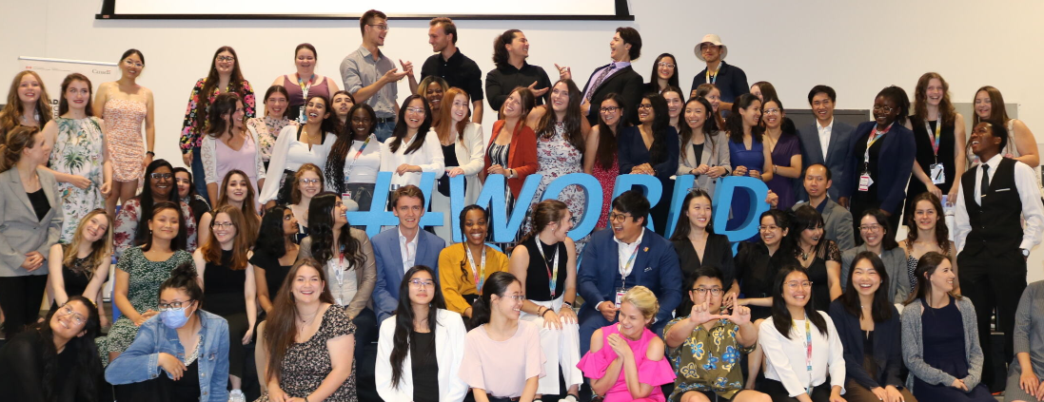
What is the Award?
For SHSM students in Grades 11/12: Bronze - (6 months – grade 11), Silver (6 months* - grade 12), if you finish your Silver – challenge yourself with the Gold Award level!
Four sections: Voluntary Service, Skills, Physical Recreation and Adventurous Journey
All while doing SHSM - be recognized for the Award and SHSM while having fun with your friends along the way!
© 2024 The Duke of Edinburgh's International Award – Canada, All Rights Reserved
Notes:
Let’s continue introducing the Award.
The Award is open to all youth aged 14 to 24.
The Award consists of four sections: Voluntary Service, Skills, Physical Recreation, and Adventurous Journey, which align perfectly with your SHSM program. Service, Skills, and Physical Recreation can be completed through activities you already do through SHSM, at school, or outside of it. The Adventurous Journey is a team activity where you'll plan and prepare an exciting overnight activity in groups of 4-8.
There are three levels of the Award, and you can progress from Bronze to Silver and finally to Gold. Each level increases in time and commitment, but the beauty is that you’re already halfway there by participating in SHSM.
Bronze takes a minimum of 6 months, Silver 12 months, and Gold 18 months, but again, a lot of what you’re doing for SHSM will count toward these hours, especially since both programs focus on real-world skills and experiences.
When you reach the Gold level, there's an exciting opportunity to undertake a Gold Project, which involves completing a team-based project away from home. For SHSM students, this could mean participating in a unique sector-specific project, like a co-op experience or field trip.
At the end of each level, you’ll have earned a prestigious, internationally recognized accreditation that stands out to colleges, universities, and employers.

Slide 5
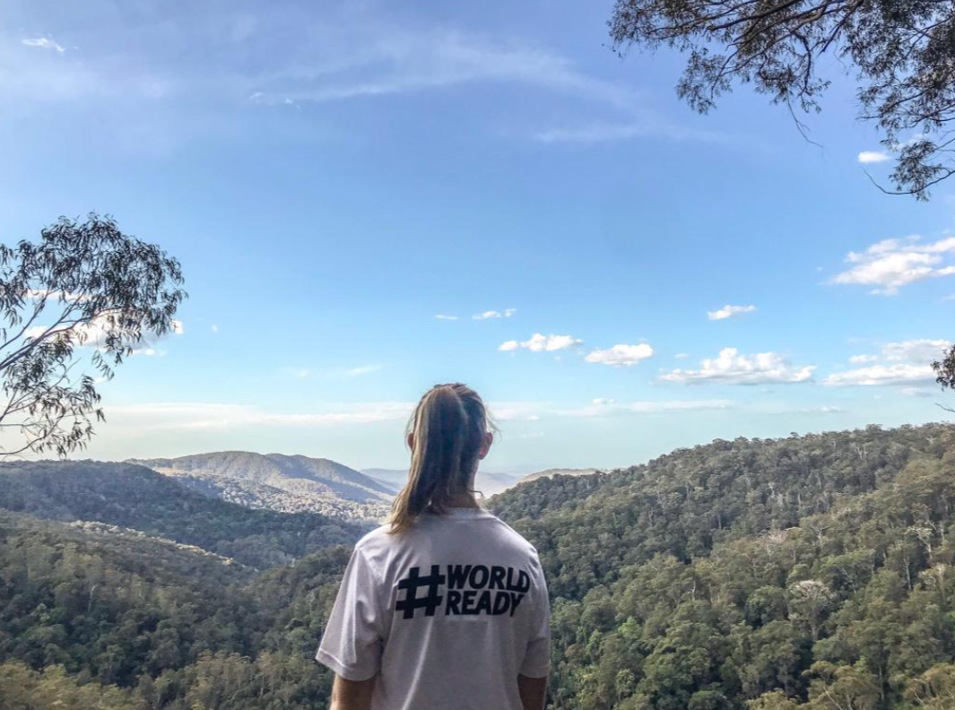
How The Award Integrates with SHSM
You’re already halfway there! The Award adds reflection and international accreditation.
Most SHSM activities are done as a group but reflected individually in the Online Record Book (ORB/Portfolio).
Align your Award activities with your SHSM sector.
Use school activities or personal interests if a section doesn’t align with SHSM.
Log SHSM certifications, class experiences, projects and more to reach your Award goals!
© 2024 The Duke of Edinburgh's International Award – Canada, All Rights Reserved
Notes:
Let’s look at how the Award seamlessly integrates with the SHSM program, enhancing your overall experience and providing even more value to your educational journey.
1. You’re already halfway there! The Award adds reflection and international accreditation.
By participating in SHSM, you’re already making significant strides. The Award complements this by introducing a reflection component and granting you international accreditation, which enhances your credibility.
2. Most SHSM activities are co-facilitated but reflected individually in the ORB.
Many of your SHSM activities will be done as a group, but the Award encourages you to reflect on these experiences individually in the Online Record Book (ORB). This personal reflection is key to deepening your understanding and growth.
3. Align your Award activities with any SHSM sector or choose what excites you.
You have the flexibility to align your Award activities with any SHSM sector. This means you can pursue interests that excite you while still meeting Award requirements. Don’t hesitate to choose activities that resonate with your passions!
4. Use school activities or personal interests if a section doesn’t align with SHSM.
If you find that a particular Award section doesn’t have a corresponding SHSM sector, you can still fulfill that requirement by using school activities or personal interests. This allows you to customize your Award experience based on what you’re already doing.
5. Log SHSM certifications, projects, and more to reach your Award goals!
You can log your SHSM certifications, projects, and various experiences as part of your Award activities. This integration means that your efforts in SHSM directly contribute to achieving your Award goals, making it a win-win situation!
In conclusion, the Award is designed to complement your SHSM experience, providing you with additional recognition, the opportunity for personal reflection, and the flexibility to pursue what you love while meeting your goals. Together, they prepare you for future success!

Slide 6
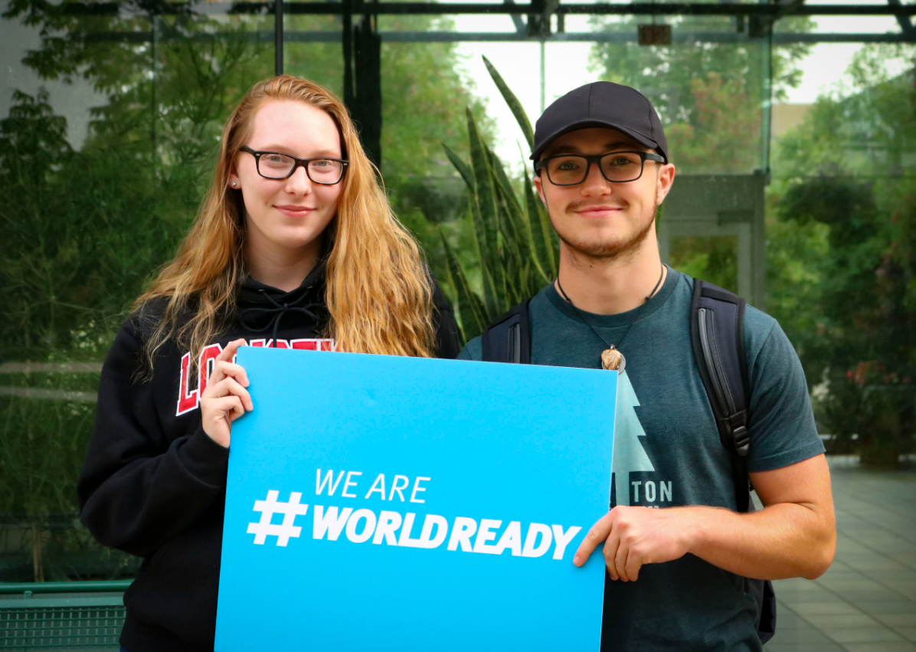
How to complete the Award
Register: Sign up on our online platform, the Online Record Book (ORB). Earn your Portfolio Cert.
Set SMART Goals: Choose activities that inspire you and create a SMART goal for each one on the ORB.
Add Assessors: Choose an adult (like your SHSM Lead or teacher) to add to each of your activities on ORB, who will guide you and assess your activity once you’ve completed it.
Log Your Hours on ORB: Aim to log 1 hour per week for 13 weeks in each section, majoring in one section for 26 weeks until completion.
Celebrate Success: Once completed, celebrate and gain international recognition for your achievements!
© 2024 The Duke of Edinburgh's International Award – Canada, All Rights Reserved
Notes:
Let’s break down how you can complete the Award step by step. The good news is that much of this overlaps with what you're already doing in SHSM, so the process is streamlined.
1. Register: The first step is to register on the Online Record Book (ORB). This platform will track your progress for the Award and SHSM, so it’s a one-stop shop where you can log all your progress.
2. Set SMART Goals: The next step is setting SMART goals—specific, measurable, achievable, realistic, and time-bound. All SHSM activities already align with the Award’s sections, so you can easily create goals that integrate both programs if you wish to do so.
3. Add Assessors: For each activity, you’ll need an assessor—this could be your SHSM Lead or a teacher who is already supporting you in SHSM. They will guide you through the process and verify your progress once you've completed the activity. This makes it easy since you’ll already be working closely with these teachers and mentors for SHSM!
4. Log Your Hours: Log your hours each week on ORB—about 1 hour per week for 13 weeks in each section, just like SHSM requires time commitments for its certifications and activities. One section will be your major focus for 26 weeks—this could align with your SHSM sector, allowing you to dive deeper into what interests you most.
5. Celebrate: When all sections are completed, it’s time to celebrate! Not only will you have finished your SHSM program, but you’ll also have earned international recognition through the Award. This achievement is something to be proud of, and it’s a powerful addition to your résumé or college applications!
Following these simple steps, you'll not only meet the requirements for the Award but also enhance your SHSM experience. The process is designed to build on what you're already doing, making it a seamless way to gain multiple credentials while focusing on your personal growth!

Slide 7
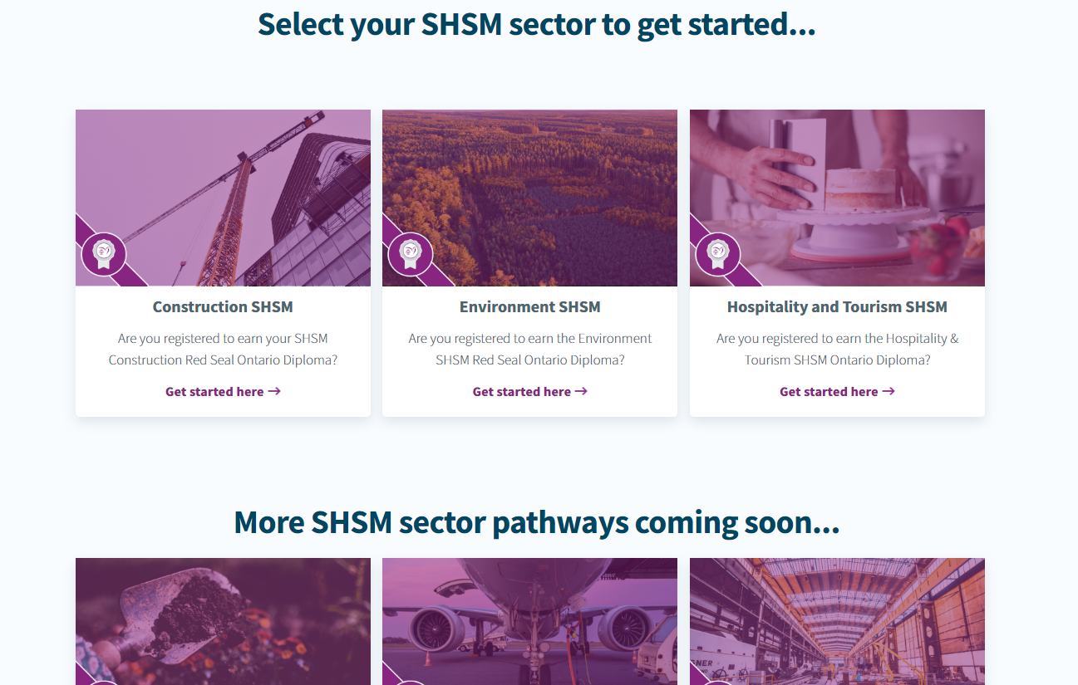
Get Creative - Use The Activity Zone!
The SHSM Activity Zone has many activity ideas! Explore our fantastic SHSM activity examples to get inspired and see how you can use your sector.
If you don't have a SHSM sector for a particular section of the Award, you can use our other Activity Zone ideas or create your own!
https://www.dukeofed.org/specialist-high-skills-major-shsm/
https://www.dukeofed.org/award-activity-zone/
© 2024 The Duke of Edinburgh's International Award – Canada, All Rights Reserved.
Notes:
The SHSM Activity Zone is a fantastic resource designed to ignite your creativity and help you explore a variety of activities that align with your interests and your SHSM sector.
1. Explore Activity Ideas
The Activity Zone offers a wide array of activity ideas specifically tailored for each SHSM sector. Whether you're interested in environmental initiatives, construction projects, or arts and culture, you can find inspiring examples to kickstart your journey. These suggestions are not just limited to traditional activities; they encourage you to think outside the box and personalize your Award experience.
2. No SHSM Sector? No Problem!
If you find that a particular section of the Award doesn’t align directly with your SHSM sector, don’t worry! The Activity Zone includes a variety of alternative ideas that you can explore. You also have the freedom to create your own activities that reflect your unique passions and interests. This flexibility allows you to tailor your Award experience to what excites you most.
So, dive into the SHSM Activity Zone and get inspired! Remember, this is your chance to combine creativity with your educational and personal interests, making your Award journey not only rewarding but also fun and engaging. Take advantage of these resources and let your imagination lead the way!

Slide 8
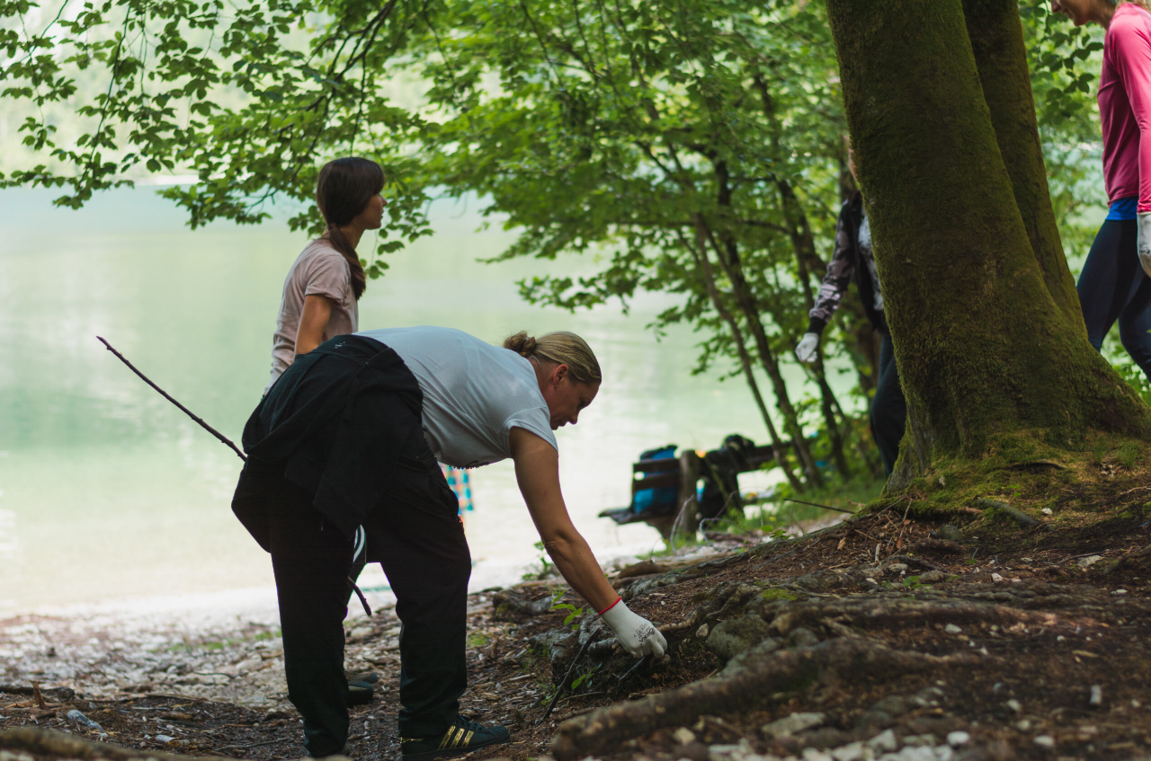
Example Journey: Combining SHSM and The Award
Voluntary Service Section (SHSM Example)
Aviation: Going to elementary schools to teach them properties of flight.
Environmental Sector: Join a clean up crew or participate in planting a tree day.
Arts and Culture: Hosting an art therapy workshop at a hospice. Hosting an art show for community.
© 2024 The Duke of Edinburgh's International Award – Canada, All Rights Reserved.
Notes:
Let’s explore some practical examples of how you can combine the SHSM program with the Award, specifically focusing on the Voluntary Service section. These examples illustrate the potential to make a meaningful impact while fulfilling both SHSM and Award requirements.
1. Aviation: Going to elementary schools to teach them properties of flight.
In the Aviation sector, you could engage in a rewarding experience by visiting local elementary schools. Here, you can teach young students about the properties of flight. This not only fulfills the Voluntary Service requirement but also allows you to share your passion for aviation and inspire the next generation!
2. Environmental Sector: Clean up crews in environmental planting a tree day.
If you’re interested in environmental issues, consider participating in a tree-planting day. Joining clean-up crews helps beautify your community and fosters a sense of responsibility for the environment. This activity aligns perfectly with both the Voluntary Service section of the Award and the SHSM environmental sector, showcasing your commitment to sustainability.
3. Arts and Culture: Hosting an art therapy workshop at a hospice.
For those in the Arts and Culture sector, hosting an art therapy workshop at a local hospice can be incredibly fulfilling. This experience allows you to use your artistic skills to provide emotional support to individuals in need. It beautifully demonstrates how the Award and SHSM can intersect to create a positive impact in the community while also enhancing your own skill set.

Slide 9
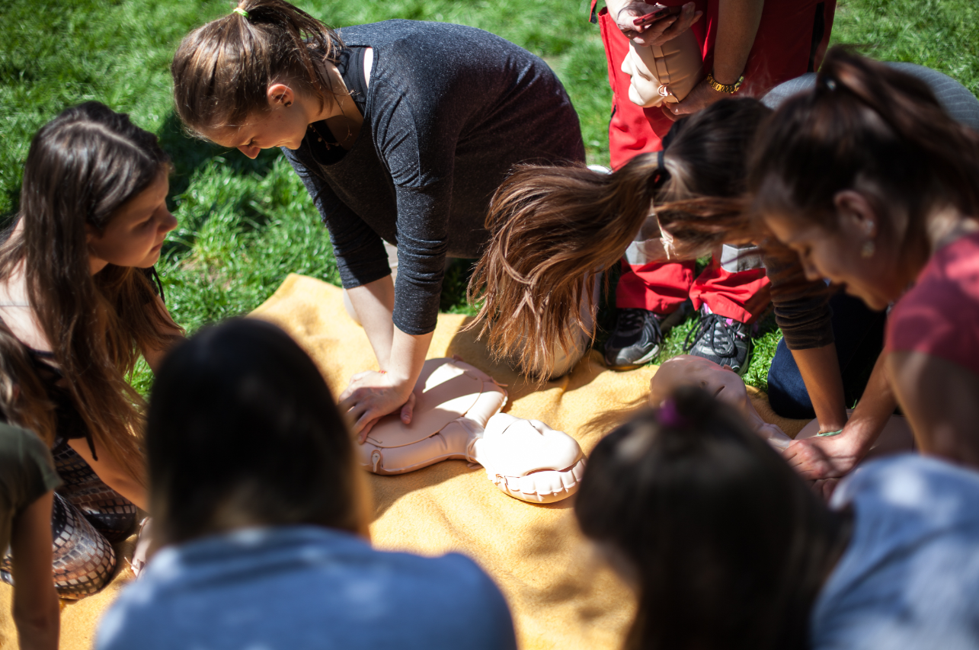
Example Journey: Combining SHSM and The Award
Skills Section (SHSM Example)
Construction: Rebuilding a deck at a non-profit historic museum.
Transportation: Learning basic vehicle maintenance, like changing oil or tires.
© 2024 The Duke of Edinburgh's International Award – Canada, All Rights Reserved
© 2024 Prix international du duc d'Édimbourg – Canada, tous droits réservés.
Notes:
Now, let’s look at how you can integrate the Skills section of the Award with your SHSM experiences.
1. Construction: Rebuilding a deck at a non-profit at a historic museum.
In the Construction sector, you could volunteer to rebuild a deck at a local non-profit organization, like a historic museum. This hands-on experience not only allows you to apply your construction skills but also contributes to preserving an important community resource. It’s a great way to gain practical skills while fulfilling your Voluntary Service and Skills section of the Award!
2. Transportation: Learning basic vehicle maintenance, like changing oil or tires.
If you’re interested in the Transportation sector, consider where you learn basic vehicle maintenance skills, such as changing oil or tires. This practical knowledge is essential for anyone interested in pursuing a career in transportation or automotive fields. Plus, it can count towards both your Skills section in the Award and your SHSM requirements, providing you with a well-rounded skill set.

Slide 10
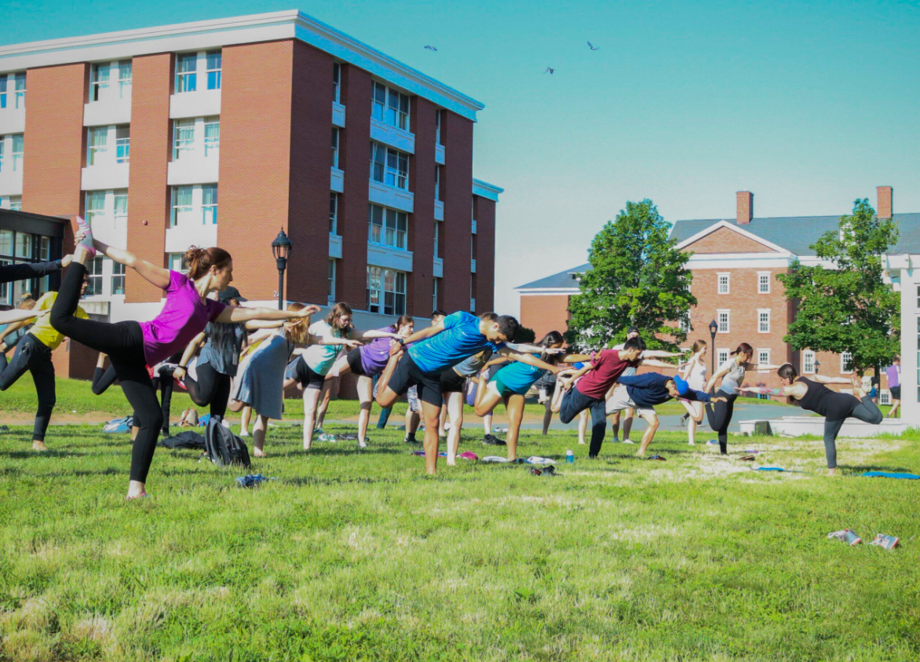
Example Journey: Combining SHSM and The Award
Physical Recreation (SHSM Example)
Hospitality and Tourism: Canoeing sessions with SHSM sector.
Construction: Physical activity and hands-on activities like building a structure.
© 2024 The Duke of Edinburgh's International Award – Canada, All Rights Reserved.
Notes:
Now, let’s explore how you can integrate the Physical Recreation section of the Award with your SHSM experiences.
Hospitality and Tourism:
Canoeing sessions with SHSM sector. In the Hospitality and Tourism sector, you might participate in canoeing sessions as part of your SHSM program. These sessions offer a fantastic opportunity to stay active while learning teamwork and leadership skills in an outdoor setting. Plus, this activity contributes to your Physical Recreation section in the Award, demonstrating your commitment to a healthy lifestyle while gaining valuable experiences in the tourism field.
2. Construction: Physical activity and hands-on activities like building a structure.
Another example is engaging in physical activity through hands-on activities in the Construction sector, such as building a structure. This not only provides an excellent workout but also allows you to apply your construction skills in a practical setting. This activity can be logged under both your Physical Recreation section and as a part of your Skills development in the Award.

Slide 11
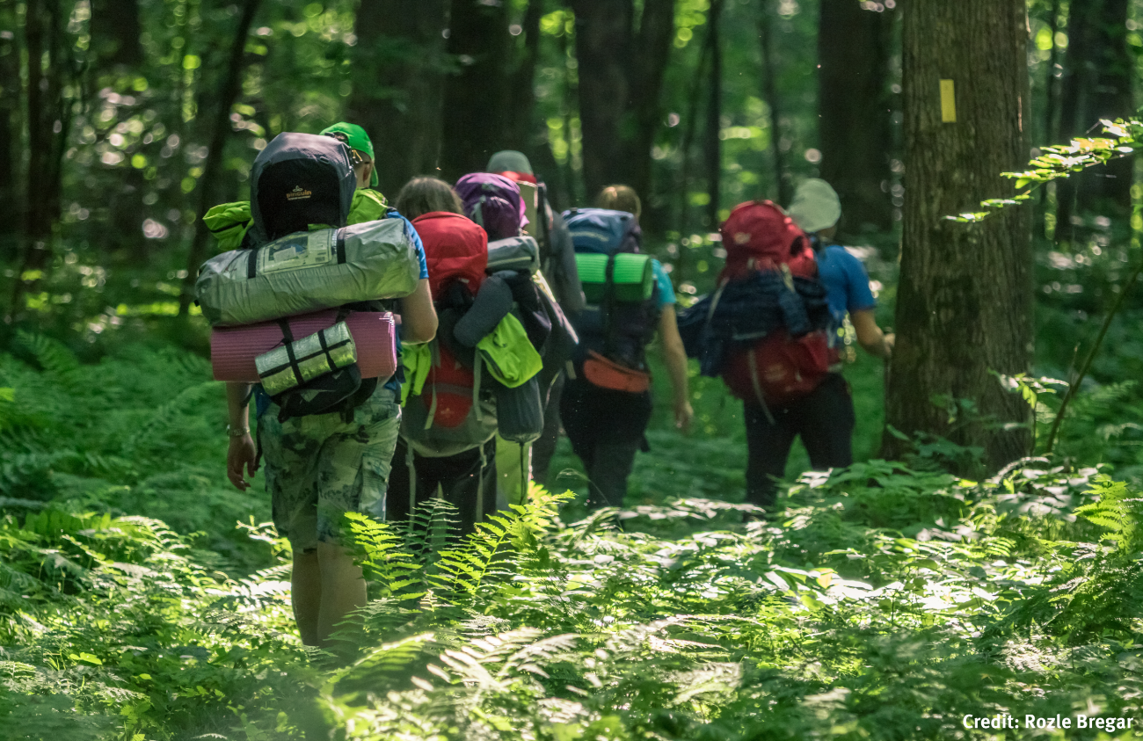
Example Journey: Combining SHSM and The Award
Adventurous Journey (SHSM Example)
Environment: Learn about wilderness survival, plant identification, and discuss the importance of habitat restoration.
Construction: Do research on community builds to find out about non-profit companies who build to give back to communities. Then, come up with ways to support them, like revitalizing a deck at a historic museum.
© 2024 The Duke of Edinburgh's International Award – Canada, All Rights Reserved.
Notes:
Now, let’s look into how the Adventurous Journey section of the Award can be enhanced through your SHSM experiences.
1. Environment: Learn about wilderness survival, plant identification, and discuss the importance of habitat restoration.
In the Environmental sector, you could embark on an Adventurous Journey focused on wilderness survival skills. This may include learning about essential techniques for surviving in the wild, identifying local plant species, and understanding the critical role of habitat restoration. Such an experience not only promotes teamwork and leadership but also deepens your appreciation for nature, making it an invaluable part of your Award journey while aligning with your SHSM focus on environmental stewardship.
2. Construction: Research community builds and support non-profit companies.
Another example involves conducting research on community builds related to the Construction sector. You could investigate non-profit organizations dedicated to building initiatives that give back to the community. Following your research, you can brainstorm ways to support these initiatives, such as revitalizing a deck at a historic museum. This hands-on project would count towards your Adventurous Journey and demonstrate your commitment to community service while applying your construction skills in a real-world context.

Slide 12
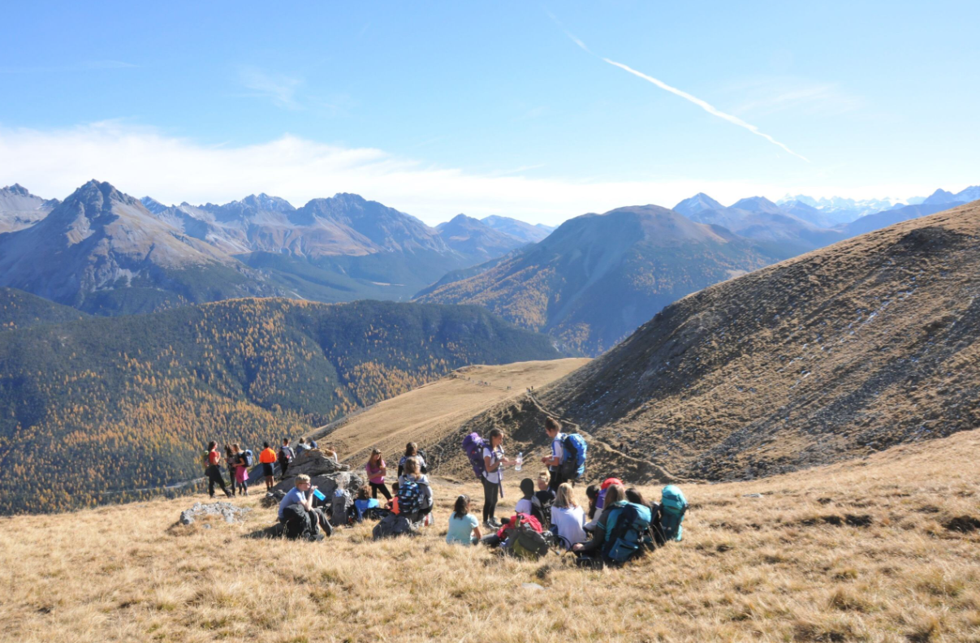
Next Steps
1. Register using the link your SHSM Lead will provide. SHSM Leads can also fill out the standardized fillable registration template (available in Month 1 Section 3 of the SHSM Delivery Playbook) beforehand to assist students in registering.
2. After registering, your SHSM Lead will host the Portfolio Development and Advanced Training in a Technology certification session where you will begin filling out activity details on ORB.
3. You’re all ready to begin! Enjoy fun, adventure, and endless possibilities!
© 2024 The Duke of Edinburgh's International Award – Canada, All Rights Reserved
Notes:
Now that you're excited about combining SHSM with the Award, let’s go over the next steps to kick off your journey!
1. Register
First things first! Register for the Award using the link provided by your SHSM Lead. This is your gateway to starting your Award journey, so make sure to complete this step as soon as possible. *In the participants tab in ORB, clicking ‘Invite Participants’ allows you to share a link with participants to register directly with your school or with a specific Award Leader that automatically fills out relevant information for them*.
2. Attend the Portfolio Development Certification Session
After registering, your SHSM Lead will host a Portfolio Development certification session. During this session, you’ll learn how to fill out the details of your activities in the Online Record Book (ORB). This is an essential step that sets the foundation for tracking your progress and accomplishments.
3. Get Ready to Begin!
Once you've completed the registration and attended the Portfolio Development certification session, you’re all set to dive into the Award! Embrace the fun, adventure, and endless possibilities that await you. Remember, this is your opportunity to grow, learn, and make a meaningful impact!

Slide 13
Q&A / Open Discussion
Any questions?
© 2024 The Duke of Edinburgh's International Award – Canada, All Rights Reserved
Notes:
Now, we’ll open the floor for any questions. Feel free to ask about how SHSM and the Award work together, how to get started, or any other concerns you might have.

Slide 14
GENERAL CONTACT DETAILS
858A King Street West Toronto, ON M5V 1P1 Phone: (437) 747-0449 Email: support@dukeofed.org
Monday – Thursday:
Chat: 10:00 - 6:00 PM EST
Phone: 11:00 - 8:00 PM EST
Charitable Registration Number: 12391 6751 RR0002
www.dukeofed.org
FOLLOW US ON SOCIAL MEDIA!
@dukeofedcanada
@dukeofedcanada
@dukeofedcanada
www.linkedin.com/company/dukeofedcanada
© 2024 The Duke of Edinburgh's International Award – Canada, All Rights Reserved

