Slide 1

Read Me First: Teacher Instructions
This interactive presentation is designed to help you guide your students in setting up most of their portfolio (ORB) by the end of the session. Look for slides with a blue icon labeled 'Interactive Activity'—these will signal when it’s time to transition to a hands-on activity.
This presentation will count towards the Portfolio Development SHSM certification, as students will be setting up their portfolio in the Online Record Book (ORB). Additionally, it will qualify as the Advanced Training in Technology SHSM certification since students will be using and learning about AI throughout the session. As an educator, you have the flexibility to decide whether to administer these certifications.
Optional speaking notes are provided for all slides. To view the notes, type 'notes' in the PowerPoint search bar and select 'Show/Hide Notes Pane’ or select the 'Notes' tab below.
© 2024 The Duke of Edinburgh's International Award – Canada, All Rights Reserved

Slide 2

Award Canada
SHSM Portfolio Development and Advanced Training in a Technology
Certification Session
© 2024 The Duke of Edinburgh's International Award – Canada, All Rights Reserved.
Notes:
Welcome! Today’s session will introduce how you can elevate your SHSM experience by adding the Award to your journey. We’ll explore how these two programs work together and how you can earn both a SHSM certification and an internationally recognized Award. You will also earn your Portfolio Development and your Advanced Training in a Technology by the end of this session.

Slide 3





Portfolio Development Certification: What's In It For You?
Boosts Employability & Applications: A portfolio showcases your ability to tell your story, share SHSM sector-specific skills and your broad personal growth from the Award, enhancing job and post-secondary prospects.
Holistic Skill Set: Combines SHSM’s technical expertise with the Award’s soft skills (e.g., leadership, teamwork), creating a well-rounded profile.
Competitive Edge: Demonstrates commitment and diverse achievements; providing an advantage in scholarships, job applications, and resilience.
Personal Growth: Encourages reflection on experiences and motivates future career and educational goals.
© 2024 The Duke of Edinburgh's International Award – Canada, All Rights Reserved.
Notes:
So, why is the Portfolio Development certification that you will receive during this session so important?
1. Boosts Employability & Applications
One of the Award’s primary goals is to help students prepare for life beyond school—whether that’s university, college, or the workplace.
A portfolio, developed through SHSM (Specialist High Skills Major) and the Award, gives you a tangible way to showcase their sector-specific skills.
This combination of technical knowledge (from SHSM) and broad personal growth (from the Award) is exactly what admissions officers and employers are looking for.
It’s a real boost to applications, as it highlights not just what students know, but how they apply those skills in the real world.
2. Holistic Skill Set
What sets this combination apart is the balance between technical and soft skills.
This makes for a well-rounded individual, someone who stands out in a crowded field of applicants.
3. Competitive Edge
In today’s competitive environment, having a diverse set of achievements is crucial.
Participation in both the SHSM and the Award shows a student’s commitment, perseverance, and ability to balance different responsibilities.
When students apply for scholarships or jobs, this combination of technical expertise and personal development can give them a significant edge over others who may not have this level of experience.
4. Personal Growth
Beyond just employability and admissions, this portfolio encourages you to reflect on your personal journeys.
You’ll take time to assess what you’ve learned, what skills you’ve developed, and how those experiences shape your future career and educational goals.
This reflection is key in fostering lifelong learning and self-improvement, motivating you to continue growing long after your formal education ends.

Slide 4
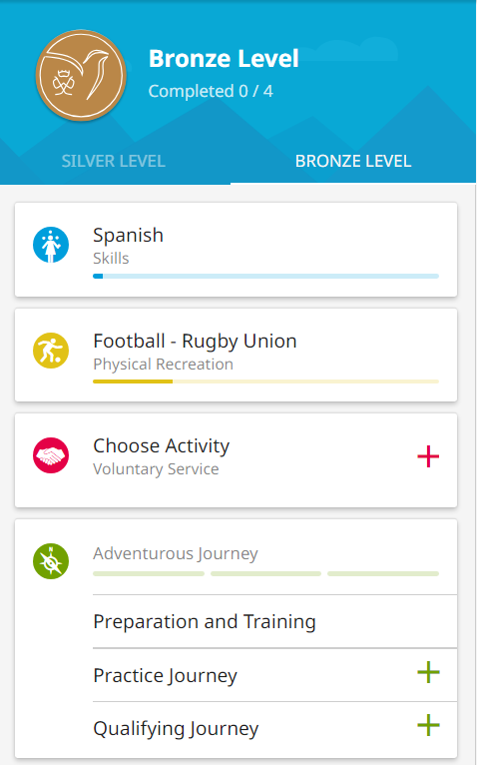
Using the ORB to Track and Showcase Your Achievements
This Portfolio Development certificate involves organizing and documenting your activities within the Online Record Book (ORB).
The ORB is a tool where you track your progress across Skills, Service, and Physical Recreation and record your Adventurous Journey!
This helps you build a record of your journey that will highlight key achievements and personal development, acting as your portfolio.
This is highly useful for future opportunities like jobs, scholarships, or further education.
© 2024 The Duke of Edinburgh's International Award – Canada, All Rights Reserved.
Notes:
This Portfolio Development Certificate is all about getting organized and keeping track of what you’re doing within the Online Record Book—or the ORB, as we like to call it.
Now, the ORB is where you’ll log your progress in three main areas: Skills, Service, and Physical Recreation. You’ll also use it to record your Adventurous Journey. So basically, everything you’re working on gets documented here.
Over time, this builds up into a really solid record of all your key achievements and how you’ve developed personally. And think about it: this kind of portfolio is super useful when you're applying for jobs, scholarships, or even further education. It really helps you stand out.
So, keeping everything in the ORB is not just a task—it’s setting you up for future success.

Slide 5




Choosing Your Major Section
You'll complete an additional 13 weeks of activity in your Major section. Select ONE of the three sections that you're most passionate about to focus on (Skill is recommended for SHSM since many students are already working on a sector focus skill through their SHSM requirements). Keep in mind, you'll still need to participate in all three sections.
Physical Recreation
Voluntary Service
Skills
Do you enjoy staying active and challenging yourself physically (e.g., sports, fitness, outdoor activities)?
Do you enjoy learning new things or developing expertise in a hobby (e.g., coding, cooking, photography)?
Are you passionate about helping others or making an impact in your community (e.g., volunteering, mentoring)?
© 2024 The Duke of Edinburgh's International Award – Canada, All Rights Reserved
Notes:
So, for your Award, you’ll need to complete an extra 13 weeks of activity in one of the three sections: Skills, Physical Recreation, or Voluntary Service. You get to choose which one you’re most passionate about. Every student who does their Bronze Award will need to choose a Major Section.
Now, Skill is often recommended for SHSM students, because many of you are already working on developing sector-focused skills as part of your SHSM requirements. It’s a great way to make progress on something you’re already doing. But remember, even though you’ll pick one section to focus on for those extra weeks, you’ll still be participating in all three sections.
If you enjoy being active, challenging yourself with sports, fitness, or outdoor activities, then Physical Recreation might be your major. If you love learning new things, maybe you're into coding, cooking, or photography, then focusing on Skills could be your path. Or, if you’re someone who’s passionate about helping others—volunteering, mentoring, or making an impact in your community—then Voluntary Service could be the best fit for you.
So really think about which section excites you the most, and that’s where you’ll put in those extra weeks.

Slide 6

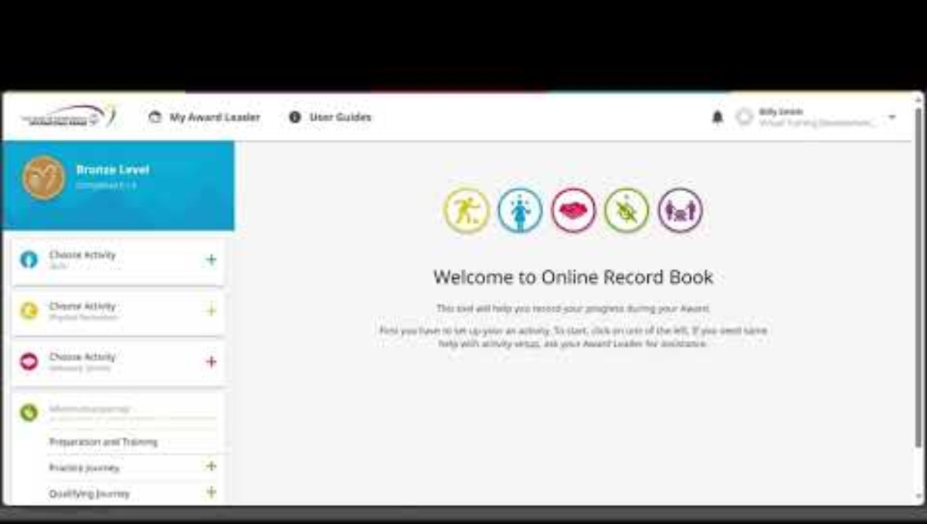
Setting Up Your Activities in the ORB
© 2024 The Duke of Edinburgh's International Award – Canada, All Rights Reserved
Notes:
Here is a video on how to set your activities up in the Online Record Book. We strongly encourage participants to have their ORB accounts open on either a computer, tablet, or phone. This will allow them to begin setting things up as they work through the rest of the activities in the slide deck.

Slide 7

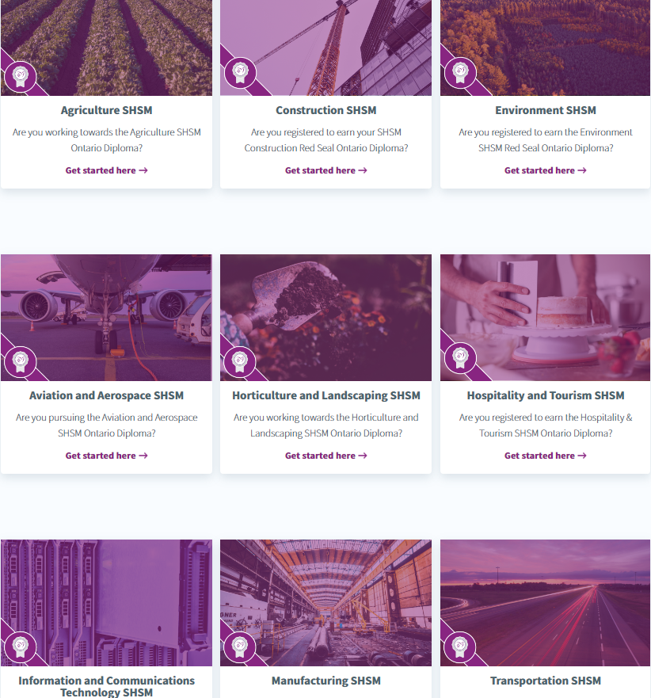
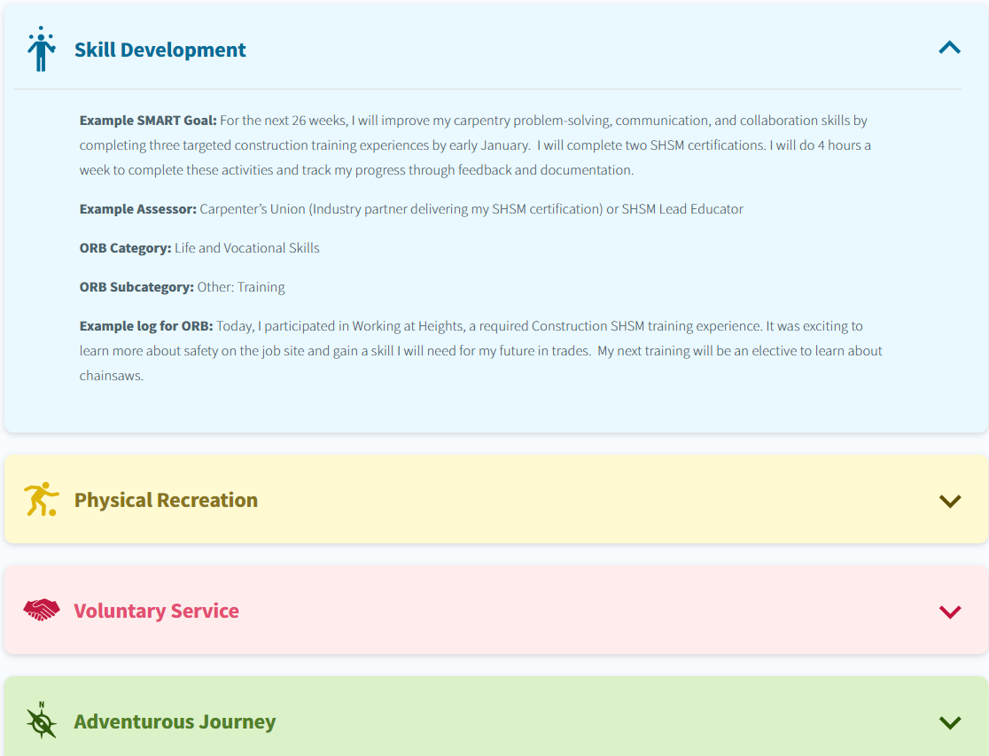
Use the Award-SHSM Activity Zone for Ideas!
Find examples of activities and SMART Goals for each of the 4 Award sections!
Choose your SHSM pathway
https://www.dukeofed.org/specialist-high-skills-major-shsm/
Notes:
Alright, when it comes to choosing your activities, you can use the Award-SHSM Activity Zone to get ideas!
Here’s how it works: first, pick your SHSM pathway here on the left—so whatever focus area you’re working on for SHSM—and then you’ll find examples of activities for each of the four Award sections: Skills, Service, Physical Recreation, and your Adventurous Journey. These examples will help you set goals that really work for what you want to accomplish.
So, if you’re ever stuck or need inspiration, the Activity Zone is your go-to resource!

Slide 8
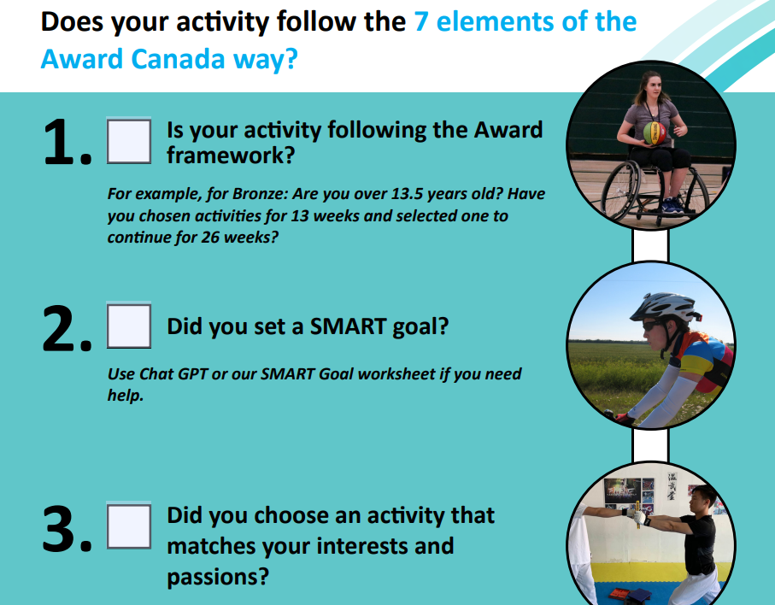
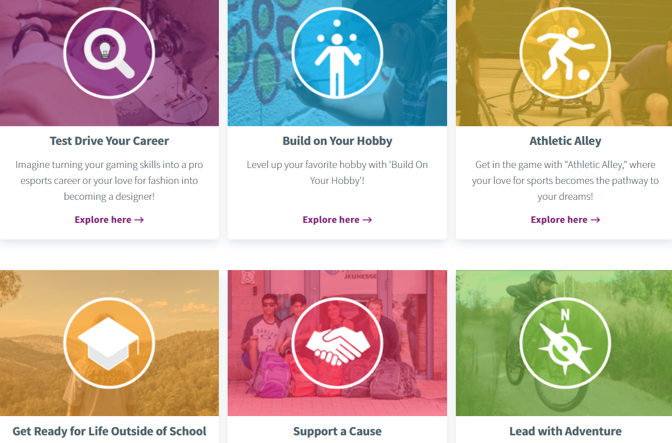
Beyond SHSM Activities
While all SHSM activities can be used for the Award, you have the flexibility to use other activities as well, for example, if you are on a team or in a club this may count toward Physical Recreation or Skill Development.
If it follows the 7 Elements of the Award Canada Way, then it can count toward the Award.
Use the Activity Zone for ideas, and the “Does Your Activity Count” resource to see if it has the 7 elements.
https://www.dukeofed.org/wp-content/uploads/2024/08/Does-your-activity-count.pdf
https://www.dukeofed.org/award-activity-zone/
© 2024 The Duke of Edinburgh's International Award – Canada, All Rights Reserved
Notes:
I want to talk about the flexibility you have in their Award journey.
First, not all activities in the Award sections need to be part of your SHSM. While SHSM activities can be utilized for the Award and are encouraged, you have the freedom to engage in other activities as well.
If you don’t have a specific SHSM activity for a section or if you’re interested in something else you’re already doing—whether that’s during school, with friends, or in your own time—those activities can absolutely count toward your Award journey. Just remember, they need to follow the 7 Elements of the Award Canada Way.
Activity Zone: https://www.dukeofed.org/award-activity-zone/
“Does Your Activity Count”: https://www.dukeofed.org/wp-content/uploads/2024/08/Does-your-activity-count.pdf

Slide 9
Setting Your SMART Goals
S
What do you want to achieve?
M
What is your target and how will you measure your progress?
A
What do you need to do to achieve your goal?
R
Do you have the ability, time, and resources to achieve your goal?
T
How often will you work towards your goal and when will you achieve it by?
Setting SMART goals will increase your chances of achieving success.
© 2024 The Duke of Edinburgh's International Award – Canada, All Rights Reserved
Notes:
Now, let’s talk about SMART Goals. You will set an individual SMART Goal for each of your 3 Award sections (Skill, Physical Recreation, and Voluntary Service) on the ORB. You will also make one team goal for the Adventurous Journey that you will each add to the ORB.
Setting clear goals is crucial for success. It provides direction, motivation, and a framework for measuring your progress. SMART goals help you break down your ambitions into manageable, achievable steps. In a few slides, we will cover the use of the Award’s AI Chat Bot to help you make your SMART Goals.
SMART stands for:
Specific: What exactly do you want to achieve? Be clear and detailed about your goal.
Measurable: What is your target? How will you track your progress? Having measurable criteria will help you see how far you’ve come.
Achievable: What do you need to do in order to achieve your goal?
Realistic: Do you have the ability, time, and resources to reach your goal? Ensure your goal is realistic and attainable based on your circumstances.
Time-bound: When will you achieve your goal? Set a specific timeline to create a sense of urgency and keep you accountable.

Slide 10
SMART Goal Examples
Physical Recreation: For 13 weeks, I will enhance my physical endurance by spending one hour a week engaging in physically demanding tasks such as harvesting, equipment maintenance, and livestock care during my SHSM placements.
Skills: For the next 26 weeks, I will improve my carpentry problem-solving, communication, and collaboration skills by completing three targeted construction training experiences by early January. I will complete two SHSM certifications. I will do 4 hours a week to complete these activities and track my progress through feedback and documentation.
Voluntary Service: I will volunteer 1 hour each week assisting with an SHSM-organized aviation safety presentation for local schools, educating students on flight safety and careers in aerospace.
© 2024 The Duke of Edinburgh's International Award – Canada, All Rights Reserved
Notes:
Now let’s talk about some examples of SMART goals to help guide you in setting your own.
For Physical Recreation, here’s a solid example: 'For 13 weeks, I will enhance my physical endurance by spending one hour a week doing physically demanding tasks, like harvesting, equipment maintenance, and livestock care during my SHSM placements.' This goal is specific, measurable, and connects directly to what you’re already doing, which is key.
Next, for Skills, here’s another example: 'For the next 26 weeks, I’ll improve my carpentry problem-solving, communication, and collaboration skills by completing three targeted construction training experiences by early January. I’ll also complete two SHSM certifications and spend four hours a week on these activities, tracking my progress through feedback and documentation.' This goal is packed with details—it’s got a clear timeline, specific tasks, and a way to measure progress.
And finally, for Voluntary Service: 'I will volunteer one hour each week assisting with an SHSM-organized aviation safety presentation for local schools, educating students on flight safety and careers in aerospace.' This goal shows how you can contribute to your community while linking it back to your SHSM focus.
So, when setting your goals, remember to make them SMART: Specific, Measurable, Achievable, Realistic, and Time-bound, just like these examples.

Slide 11

Use the Award’s AI Chat Bot to Help you Make SMART Goals!
The Award’s AI Chatbot is here to assist you!
Ask it questions, use it to help you make SMART goals, and track your progress.
It is on the bottom right corner of the Award homepage: https://www.dukeofed.org/
Our robot friend here was AI generated!
© 2024 The Duke of Edinburgh's International Award – Canada, All Rights Reserved
Notes:
On this slide, you’ll see how the Award’s AI chatbot is a valuable tool that’s here to assist you. The chatbot can help you ask questions, set goals, and track your progress throughout your Award journey. One of the most powerful ways to use it is to create SMART goals. In this session, we’ll learn how to use the chatbot effectively and how doing so and learning about AI will help you earn your advanced training in a technology certification during this session as well.

Slide 12

What is AI?
AI = Artificial Intelligence
AI helps with decision-making, problem-solving, and goal-setting
Just like a calculator for math, AI supports you in learning and planning
Why Use AI?
Earn an Advanced Training in a Technology certification
Get assistance with SMART goals and other questions
Enhance your learning and stay organized
© 2024 The Duke of Edinburgh's International Award – Canada, All Rights Reserved
Notes:
As you can see on the slide, AI stands for Artificial Intelligence. It’s a technology that helps with tasks like decision-making, problem-solving, and goal-setting—things we do every day! Think of it like a calculator but for more complex tasks. Just like a calculator helps with math, AI helps you with learning and planning.
By engaging with AI, you can earn your Advanced Training in a Technology certification as part of the SHSM program. You’ll also receive help with creating and tracking SMART goals, keeping you organized and on track. AI is here to make learning easier while giving you valuable skills that will be useful both now and in the future.

Slide 13
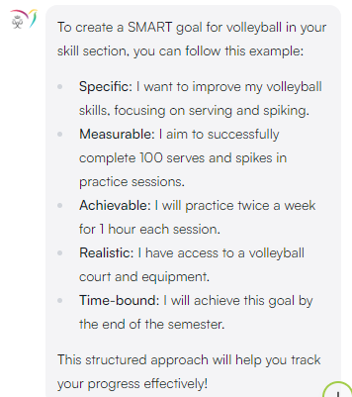
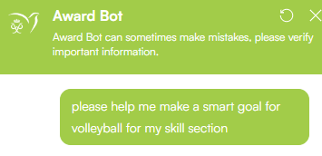
Making SMART Goals with AI
© 2024 The Duke of Edinburgh's International Award – Canada, All Rights Reserved
Notes:
By using the AI chatbot, you can easily create SMART goals. For example, you can ask it to guide you through each step to ensure your goals are clear and achievable, setting you up for success. And because you’re using this technology, it counts toward your advanced training in SHSM.
Here’s an example of how the AI chatbot can help you. As you see on the slide, if you ask the chatbot for help with a volleyball goal, it will break it down using the SMART format. For example, it can suggest a specific number of spikes and blocks to measure your progress, ensuring your goal is achievable and time-bound.

Slide 14

Ethical Use of AI
AI is a tool, not a replacement for thinking
Double-check important information
Use it to support, not replace your learning
Follow school and program guidelines for ethical use
Teachers should model responsible AI use for students
© 2024 The Duke of Edinburgh's International Award – Canada, All Rights Reserved
Notes:
On this slide, we focus on the ethical use of AI, which is crucial for both students and teachers to understand. First, remember that AI is a tool designed to assist you, but it’s not a replacement for your own critical thinking. You should always double-check important information, especially for assignments or official tasks, because AI, like any technology, can make mistakes.
In this session, and throughout your Award journey, it’s important that you use AI to support your learning, not to do the thinking for you. This means you should engage with it thoughtfully—ask it for guidance but take responsibility for your final decisions and work. Remember, AI is here to support your learning—not replace your own thinking and decision-making. Being mindful of this will help you use the technology responsibly and effectively as part of both the Award and your SHSM training.
I encourage all of you to get started with AI! Use it today to help with your SMART goals and continue to integrate it into your Award journey. The chatbot is here to help you stay organized and on track.

Slide 15
Interactive Activity:
Now, let’s make and set up our SMART Goals on ORB!
© 2024 The Duke of Edinburgh's International Award – Canada, All Rights Reserved.
Notes:
Alright, now it’s time to focus on the ORB and set up our SMART goals! This is where you’ll create goals that are Specific, Measurable, Achievable, Realistic, and Time-bound—just like we talked about earlier.
Take a minute to think about the activities you might choose for each section: Physical Recreation, Skills, and Voluntary Service. Then, we’ll use those to create your SMART goals. It’s okay if you don’t have all your activities set up by the end of this, but it’s really important that you have your Major section set up, and ideally one other section. Don’t forget, we’ll do the Adventurous Journey at another time when the journey is planned out.
If you get stuck, just let me know—I’m here to help! Let’s get those goals written and ready to go!

Slide 16
Finding Assessors for your Award Activities
An Assessor is an experienced, knowledgeable adult who helps guide and evaluate your progress in your chosen activity—whether it's Physical Recreation, Skills, or Service.
You will need an Assessor for each Award section. This can be your SHSM Lead, a teacher, industry partner delivering SHSM certification, etc., just no immediate family members.
Skills
Voluntary Service
Physical Recreation
Monitors your progress in developing a skill (e.g., painting, programming, playing a musical instrument).
Evaluates your contribution to volunteer or community service activities (e.g., animal shelter work, tutoring, environmental cleanups).
Assesses your improvement and participation in any physical activity (e.g., swimming, basketball, hiking).
© 2024 The Duke of Edinburgh's International Award – Canada, All Rights Reserved
Notes:
Alright, let’s talk about Assessors. An Assessor is basically an experienced, knowledgeable adult who’s there to help guide and evaluate your progress in your chosen activity—whether that’s Physical Recreation, Skills, or Service. For the Adventurous Journey, you will have a group Assessor.
You’ll need an Assessor for each Award section. This could be your SHSM Lead, a teacher, or even an industry partner delivering your SHSM certification. The only thing is, they can’t be an immediate family member.
So, for Physical Recreation, your Assessor will look at your participation and improvement in activities like swimming, basketball, or hiking.
For Skills, they’ll track your progress in developing a specific skill, whether it’s painting, programming, or learning to play an instrument.
And for Voluntary Service, they’ll evaluate your contribution to volunteer work or community service, like working at an animal shelter, tutoring, or doing environmental cleanups.
Their feedback is important because it shows that you’re making progress and helps validate your experience as part of the Award.

Slide 17
Interactive Activity:
Now let’s choose and add our Assessors to ORB!
© 2024 The Duke of Edinburgh's International Award – Canada, All Rights Reserved.
Notes:
Okay, now it’s time for the next step—let’s choose and add our Assessors to the ORB!
Remember, for each section—Physical Recreation, Skills, and Voluntary Service—you’ll need to pick an Assessor who’s knowledgeable in that area. This could be your SHSM Lead, a teacher, or an industry partner, just not a family member.
Let’s add them into the ORB, so they’re linked to your activities. If you’re not sure who to choose or need any help with this, just raise your hand—I’m happy to guide you through it.
Let’s get those Assessors added and ready to support you!

Slide 18
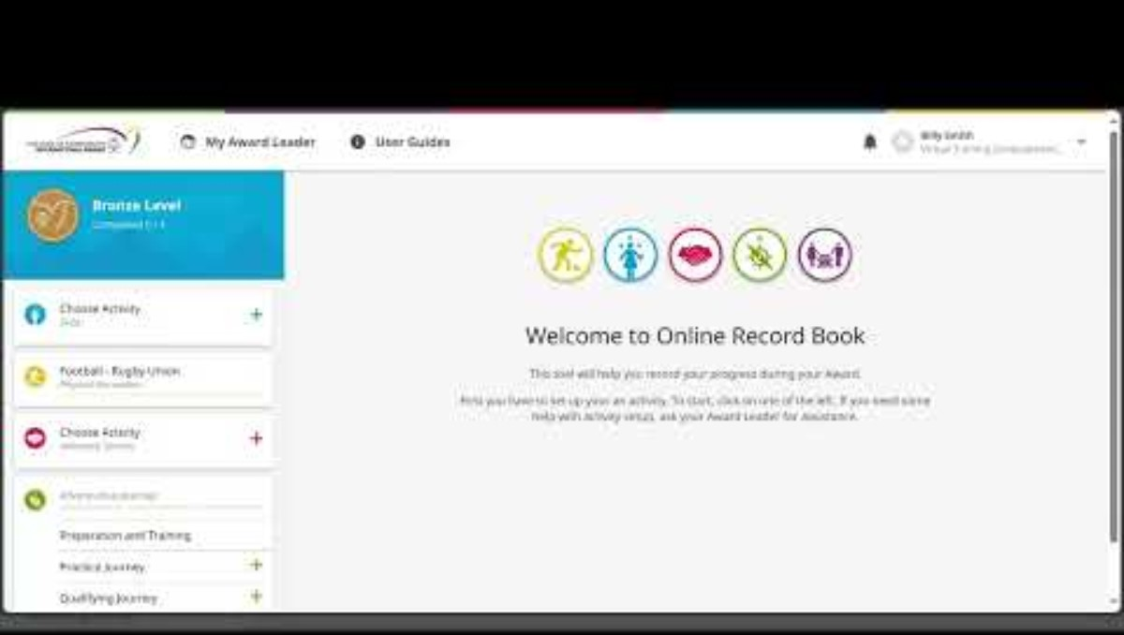
Next Steps – Logging and Tracking Your Progress!
© 2024 The Duke of Edinburgh's International Award – Canada, All Rights Reserved.
Notes:
Alright, now we’re going to watch a quick video that walks you through the next steps for logging and tracking your progress in the ORB.
This video will show you exactly how to update your activities, track your hours, and keep everything organized. It’s super helpful for making sure you stay on top of things as you work through each section of the Award.
After the video, if you have any questions or need clarification, just let me know. Let’s press play and get started!

Slide 19
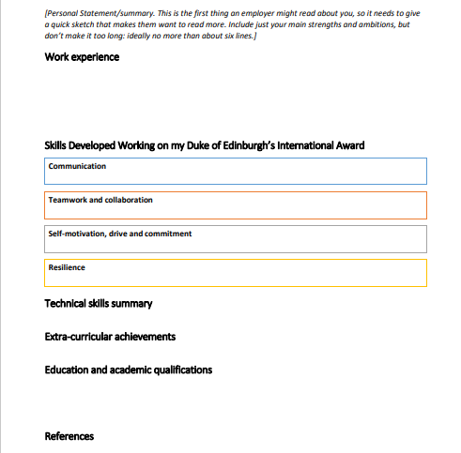
Further Developing Your Portfolio
At the end of your Award, you’ll also have the chance to use the Award’s resume template to build your resume/cover letter to showcase your achievements!
Your SHSM and Award experiences have helped you develop soft skills and technical skills. It’s important to highlight these on your resume.
You’ll stand out if you can show motivation, a strong work ethic, and the ability to collaborate well with others.
The Award’s Sample Resume Template
© 2024 The Duke of Edinburgh's International Award – Canada, All Rights Reserved
Notes:
Now, let’s talk about how you can further develop your portfolio at the end of your Award. You’ll have the opportunity to use the Award’s resume template to create a polished resume and cover letter that showcase all your achievements!
Your SHSM and Award experiences are more than just activities; they’ve helped you build valuable soft skills and technical skills that are essential for success in both personal and professional settings. When you’re applying for jobs, apprenticeships, or even post-secondary programs, it’s really important to highlight these skills. They set you apart from others.
Remember, showing motivation, a strong work ethic, and your ability to collaborate with others will make a huge difference. So, when you’re putting together your resume, think about all the experiences you’ve gained through your SHSM and the Award, and how they’ve shaped you.
This is your chance to really shine and demonstrate what you can bring to the table!

Slide 20
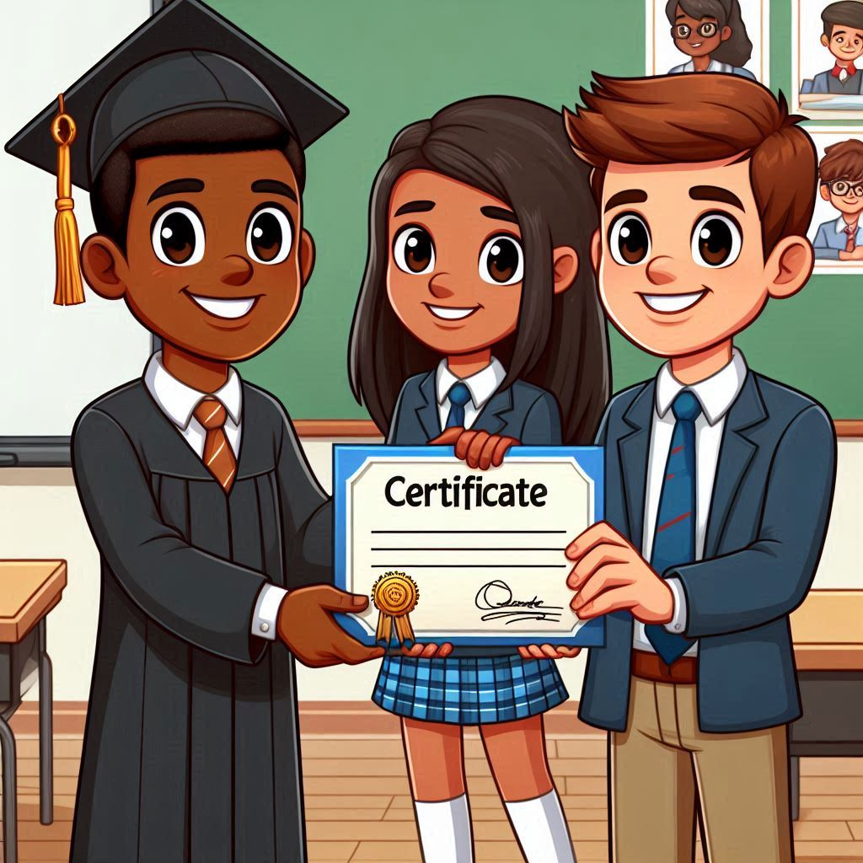
Congratulations! 🎉
Congratulations! You’ve just earned your Portfolio Development Certification and your Advanced Training in a Technology Certification!
Your SHSM Lead will take the next steps in administering these certifications to you.
© 2024 The Duke of Edinburgh's International Award – Canada, All Rights Reserved
© 2024 Prix international du duc d'Édimbourg – Canada, tous droits réservés.
Notes:
Congratulations, everyone! You’ve just achieved a fantastic milestone by earning your Portfolio Certification and your Advanced Training in a Technology Certification! Your SHSM Lead will be handling the next steps to get these certifications administered to you, so stay tuned for that.
This certification not only adds value to your portfolio but also enhances your skills, opening up new opportunities for you in the future. Celebrate this achievement—you’ve earned it!

Slide 21




GENERAL CONTACT DETAILS
858A King Street West
Toronto, ON M5V 1P1
Phone: (437) 747-0449
Email: support@dukeofed.org
Monday – Thursday:
Chat: 10:00 - 6:00 PM EST
Phone: 11:00 - 8:00 PM EST
Charitable Registration Number:
12391 6751 RR0002
www.dukeofed.org
FOLLOW US ON SOCIAL MEDIA!
@dukeofedcanada
@dukeofedcanada
@dukeofedcanada
www.linkedin.com/company/dukeofedcanada
© 2024 The Duke of Edinburgh's International Award – Canada, All Rights Reserved

